Slide 1

Messaging With Limits
Concurrent, Multi-Stage Data Processing in the Real World
Notes:
Good afternoon everybody! Today we’re going to be going over a use case of a multi-stage Broadway pipeline that we built to send text messages

Slide 2

Brian Meeker
Website
https://brianmeeker.me
GitHub
@CuriousCurmudgeon
Mastodon
@brianmeeker@hachyderm.io
Notes:
My name is Brian Meeker. I spend my work hours as an Elixir dev at GetThru. I only started working in Elixir professionally a couple of years ago, so I'm excited to make it to my first Elixir Conf.
You can mostly find me these days on Mastodon. These slides will be available on GitHub. I'll have a QR code link at the end to the repo.

Slide 3

Notes:
GetThru provides texting and calling tools for progressive political campaigns, non-profits, and universities. As you might have noticed, it's a presidential election year in the US, which means a lot more usage of our system. That led us to reevaluate our infrastructure to handle the load.

Slide 4


Notes:
We have two main products.
For today though, we’re only going to be looking at ThruText. You might send text about your university's giving day or a get out the vote campaign. People don’t want to answer phone calls from an unrecognized number, but they will glance at a text message.

Slide 5

Providers
Notes:
Before we get start looking at our system, let's go over a bit of domain terminology.
First, we send text messages and we do that through providers. We don’t talk directly to carriers. Instead, providers are the services we use to send text messages through. Everybody here has probably heard of Twilio, but there are many others out there and we rely on multiple of them.

Slide 6




Carriers (or Mobile Network Operators)
Notes:
Mobile Network Operators are carriers like AT&T, Verizon, T-Mobile, and US Cellular. In the US, those are basically it for physical infrastructure. Importantly for later, when we send somebody a text message, we need to know who the underlying mobile network operator is.

Slide 7

Notes:
Sending limits are regulated by an industry group called The Campaign Registry (TCR). Our old system had issues, but this is what really broke it.
TCR is an attempt at industry self-regulation by carriers to prevent federal regulation on application-2-person texting. They require brands to submit information about themselves and their campaigns up front to provide traceability about the who and what of a campaign.
The quality of the information they submit and their use case will be part of determining if they are approved, and, if approved, what their rate limits are.
TCR was announced in 2021 and went into effect in 2022. Our current system has been struggling with it ever since. In 2023 we decided that continuing to build on the old system was not sustainable. We needed to start fresh.

Slide 8


Notes:
This fresh start is built around Broadway and Rabbit. Broadway completely new to use. We already had limited use of Rabbit in our stack, but this project was going to really force us to learn how Rabbit works.

Slide 9

Super Collider
Notes:
We code named this new project the Super Collider. And I will say, as someone who has historically rolled his eyes at cute project code names, AI image generation has made them a lot more fun than they used to be.

Slide 10
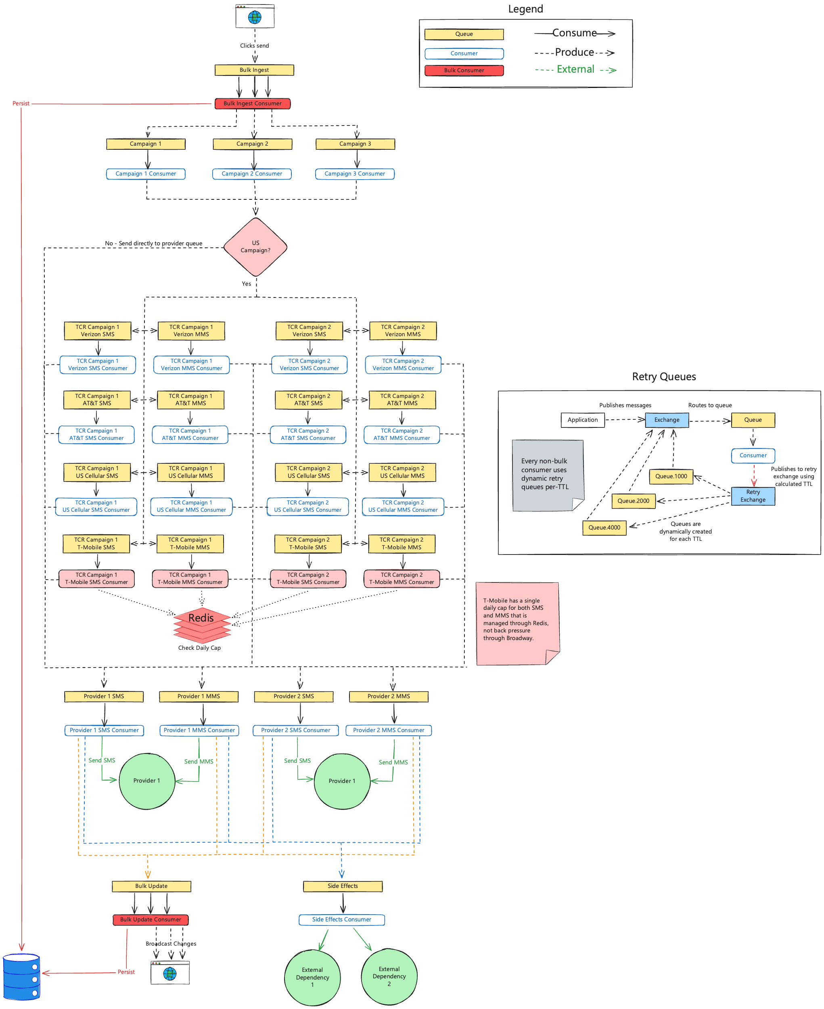
Any questions?
Notes:
So, this is it. Let’s ship it.
Any questions? Does everybody feel like they understand the system just from this diagram? We don’t have time to go over everything today, but let’s speed run through the stages.

Slide 11
Bulk Ingest
Notes:
Our pipeline starts when a user clicks a button to send a message. We want to make sure that messages gets into our database up front. Our legacy system did this too, but it did it immediately for every single message. One of our goals in the new system was to lessen the load on the DB. This was a prime opportunity to do that.

Slide 12
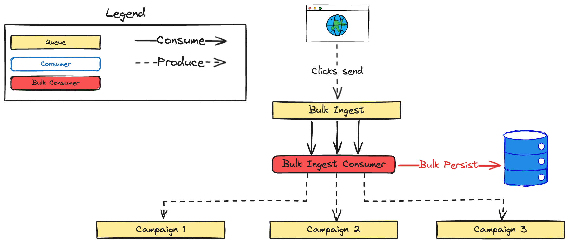
Notes:
Instead of persisting each message individually, we’re going to persist them in batches with bulk insert operations. Broadway supports this out of the box.
After all of that data is persisted, each message is sent along to the queue for the correct campaign queue in the next stage.

Slide 13
Campaign
Notes:
Our customers send messages as part of what we call "campaigns" in our domain. It looks roughly like this

Slide 14
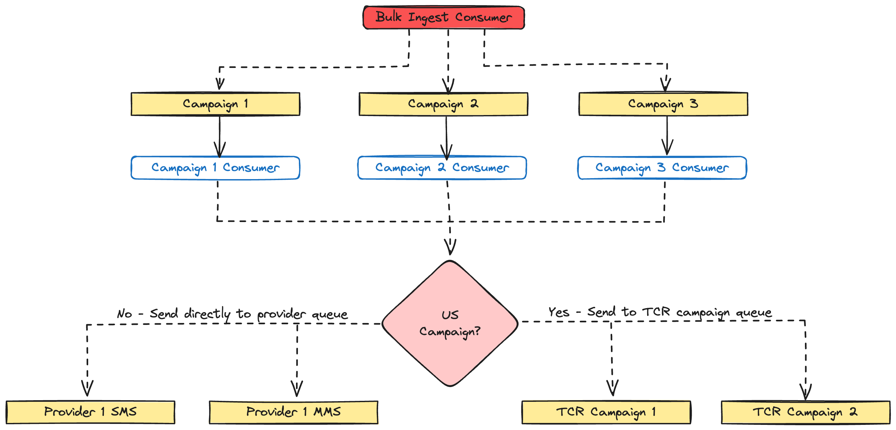
Notes:
Each campaign gets its own queue and consumer. When a campaign is launched, we dynamically create a queue in RabbitMQ for that campaign.
In addition to the GetThru campaign queue, we’re also going to dynamically start a Broadway consumer process. That process will then start consuming messages from the corresponding GetThru campaign queue.
Most of our pipeline stages are very simple. The campaign stage exists purely to check if the campaign is in the US so we can route messages correctly. We also turn this stage on and off at certain hours of the day for each campaign. Nobody wants political text messages in the middle of the night.

Slide 15
Send Message
Notes:
Non-US campaigns aren’t subject to TCR, so we can push messages directly to our Send Message Stage. This is where we make an API to one of our providers to send a text message.

Slide 16
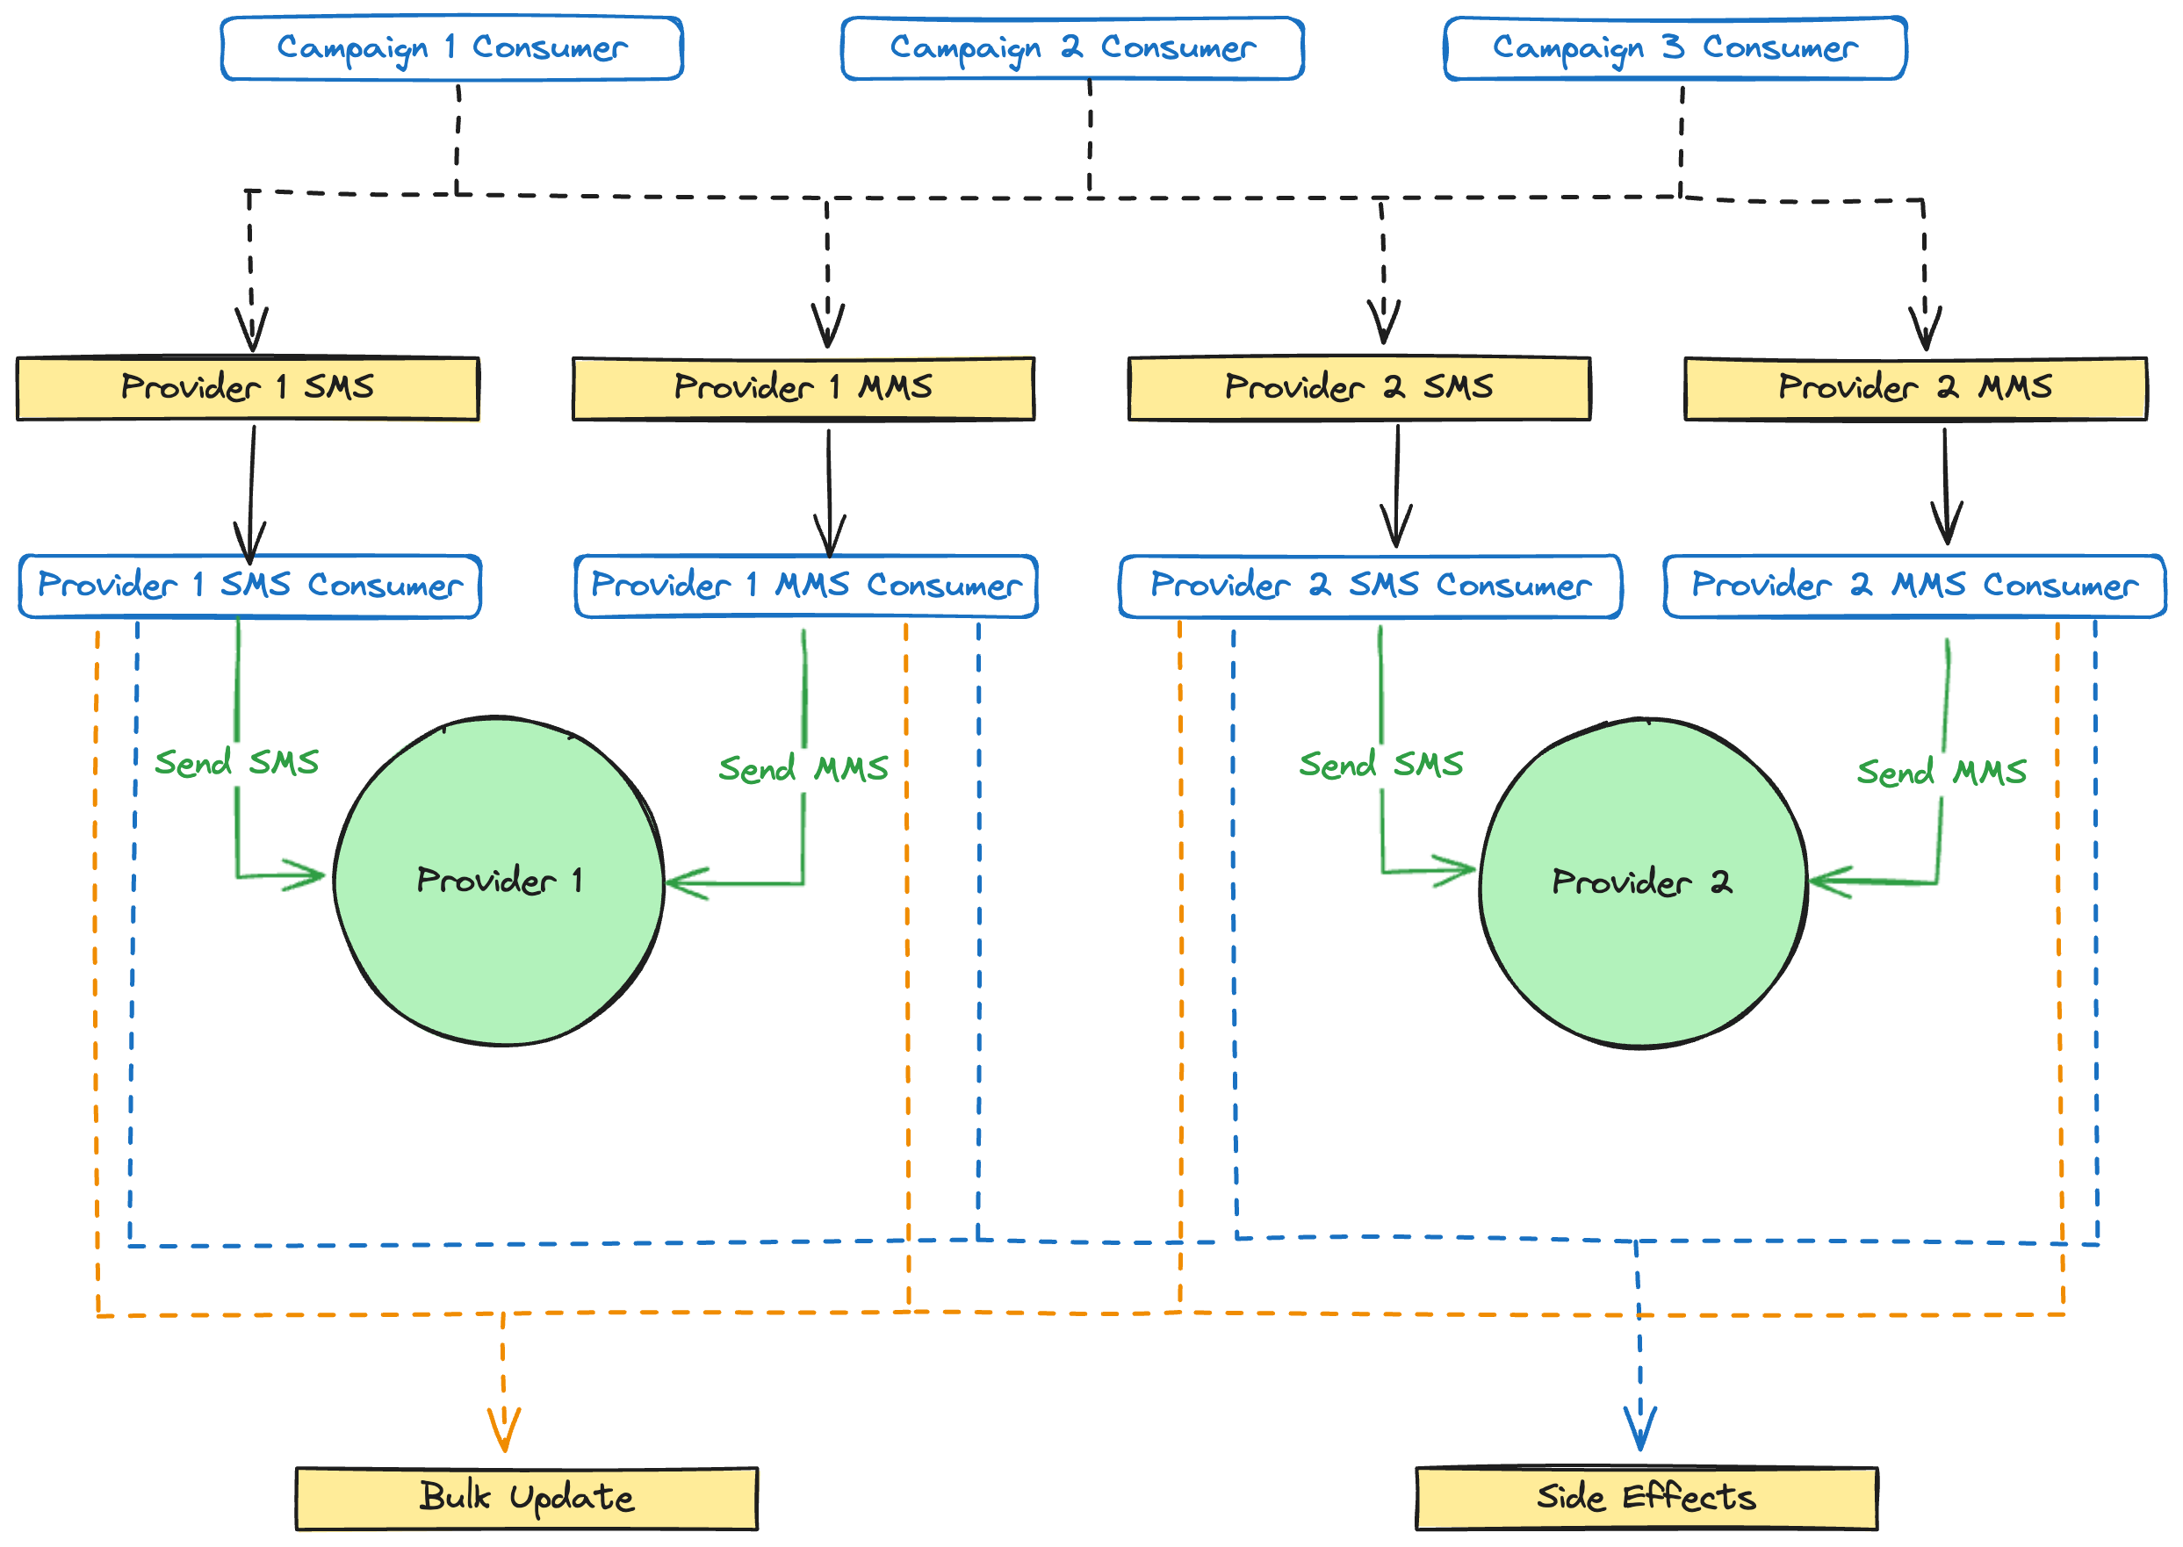
Notes:
There are separate queues for both SMS and MMS messages for each provider. This is because each provider has a separate rate limit for how many SMS and MMS messages you can send in a window. For example, a provider may allow you to send 500 SMS messages per minute, but only 250 MMS messages per minute. We do this through Broadway back pressure
Assuming a consumer can successfully send an SMS or MMS to the provider, we then publish two Rabbit messages. One will go to a bulk update queue and the other will go to a side effects queue.

Slide 17
Bulk Update
Notes:
Now we’ve made an API call to a provider to send a text message, but we still need to update our DB to reflect that the message has been sent.

Slide 18
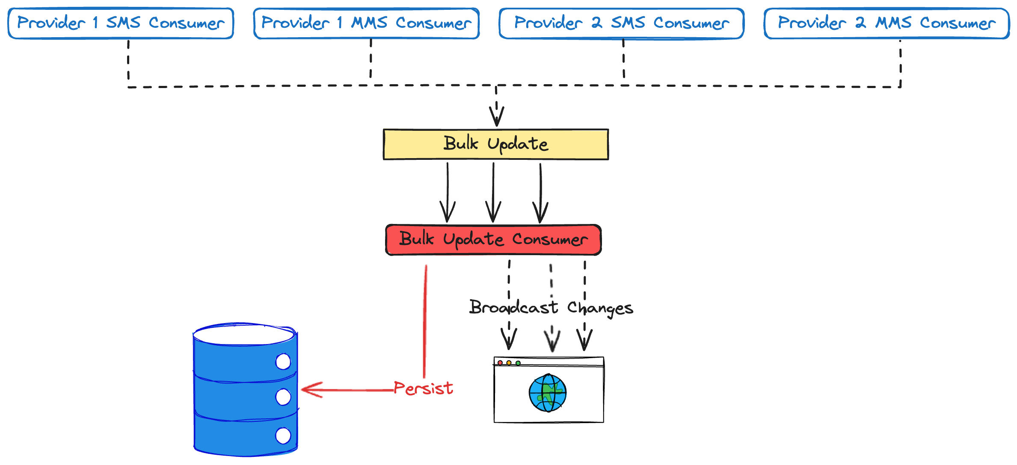
Notes:
To do that, we added a bulk update stage. It uses the same kind of batching we do for bulk ingest.
We insert into the DB and then broadcast info about the message. Maybe the UI needs to update in some way. Maybe some other system cares. In many other ecosystems, this would be another job for the message broker. We just use Phoenix PubSub.

Slide 19
😰
Carrier
Notes:
That does it for our non-US customers. But what about this big middle part of the diagram? This is where The Campaign Registry and carrier rate limits live.
Remember that TCR is the carrier industry’s attempt at self-regulation of A2P text messaging. They want to allow A2P text messages (and profit from them) for various use cases, but keep them from being so annoying that the federal government steps in with regulation.

Slide 20
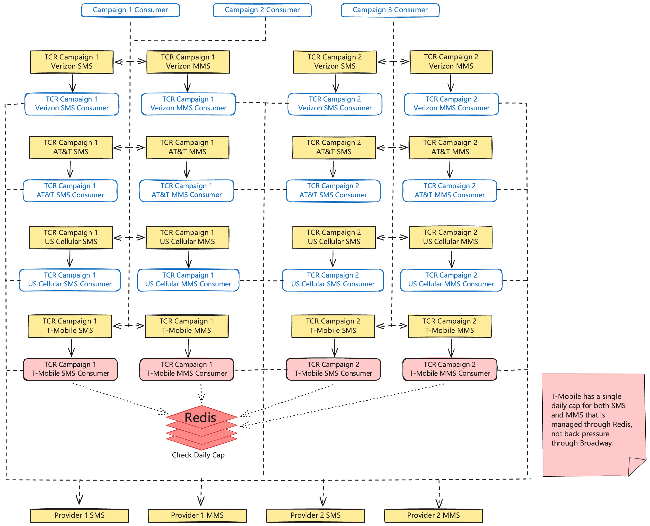
Notes:
We end up with separate queues and consumers for each carrier and TCR campaign combination. TCR tells how what our rate limits are for each carrier. All these rate limits are enforced through back pressure, except for T-Mobile. They use a daily cap that we have to enforce through a counter in Redis.

Slide 21
Notes:
That was a speed run through our pipeline.

Slide 22
Campaign Sending Windows
Notes:
There are sending windows each day when we’re allowed to send text messages for a campaign.
The way we enforce this is by dynamically creating parts of our topology when a campaign opens and tearing it back down when a campaign closes for the day.

Slide 23
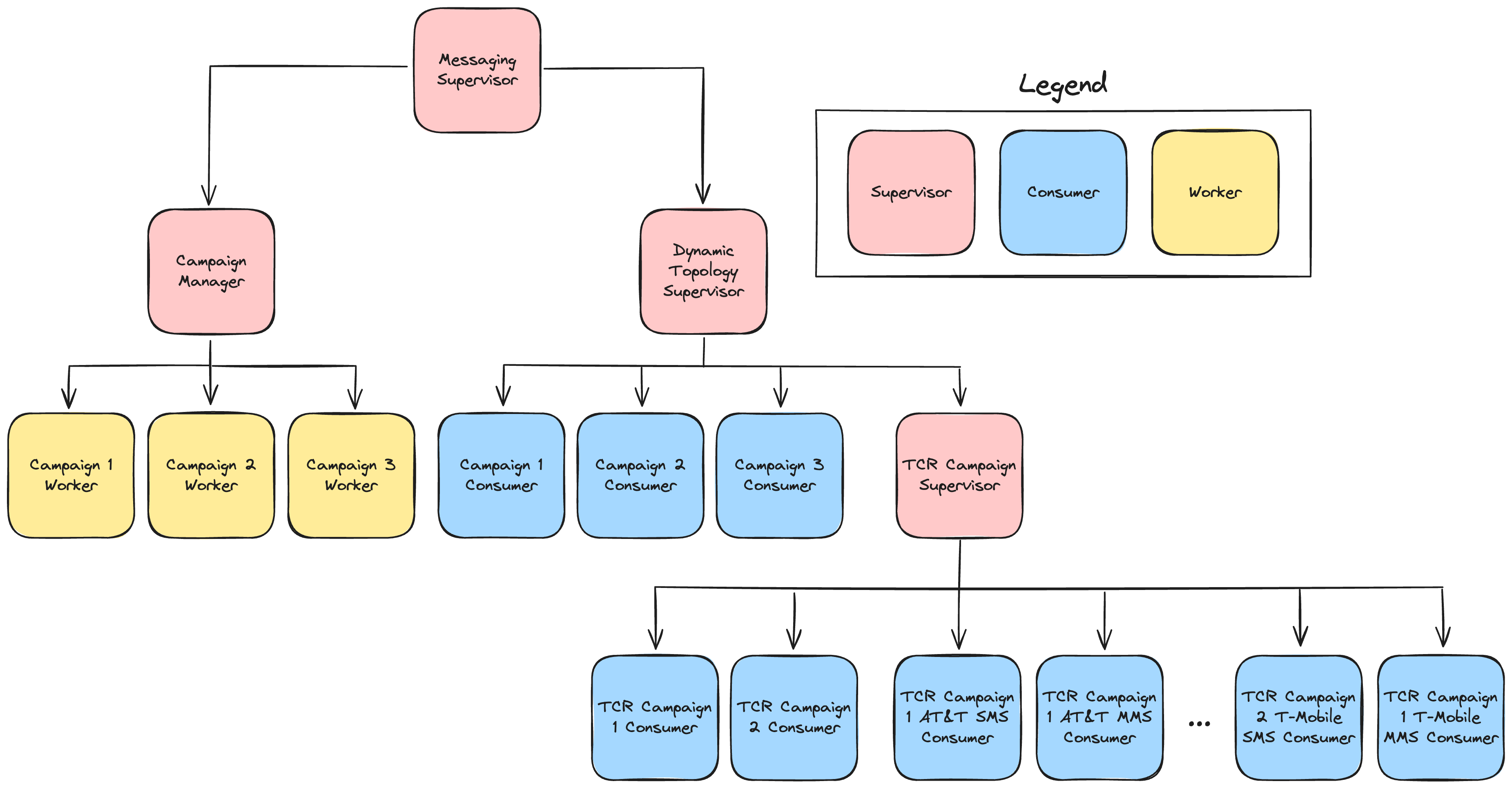
Notes:
We lean hard into processes for this.
This is a simplified supervision tree for part of our application. When the application starts up, we create a campaign worker process for every active GetThru campaign in our system. Each campaign worker process is responsible for managing Broadway consumers.

Slide 24
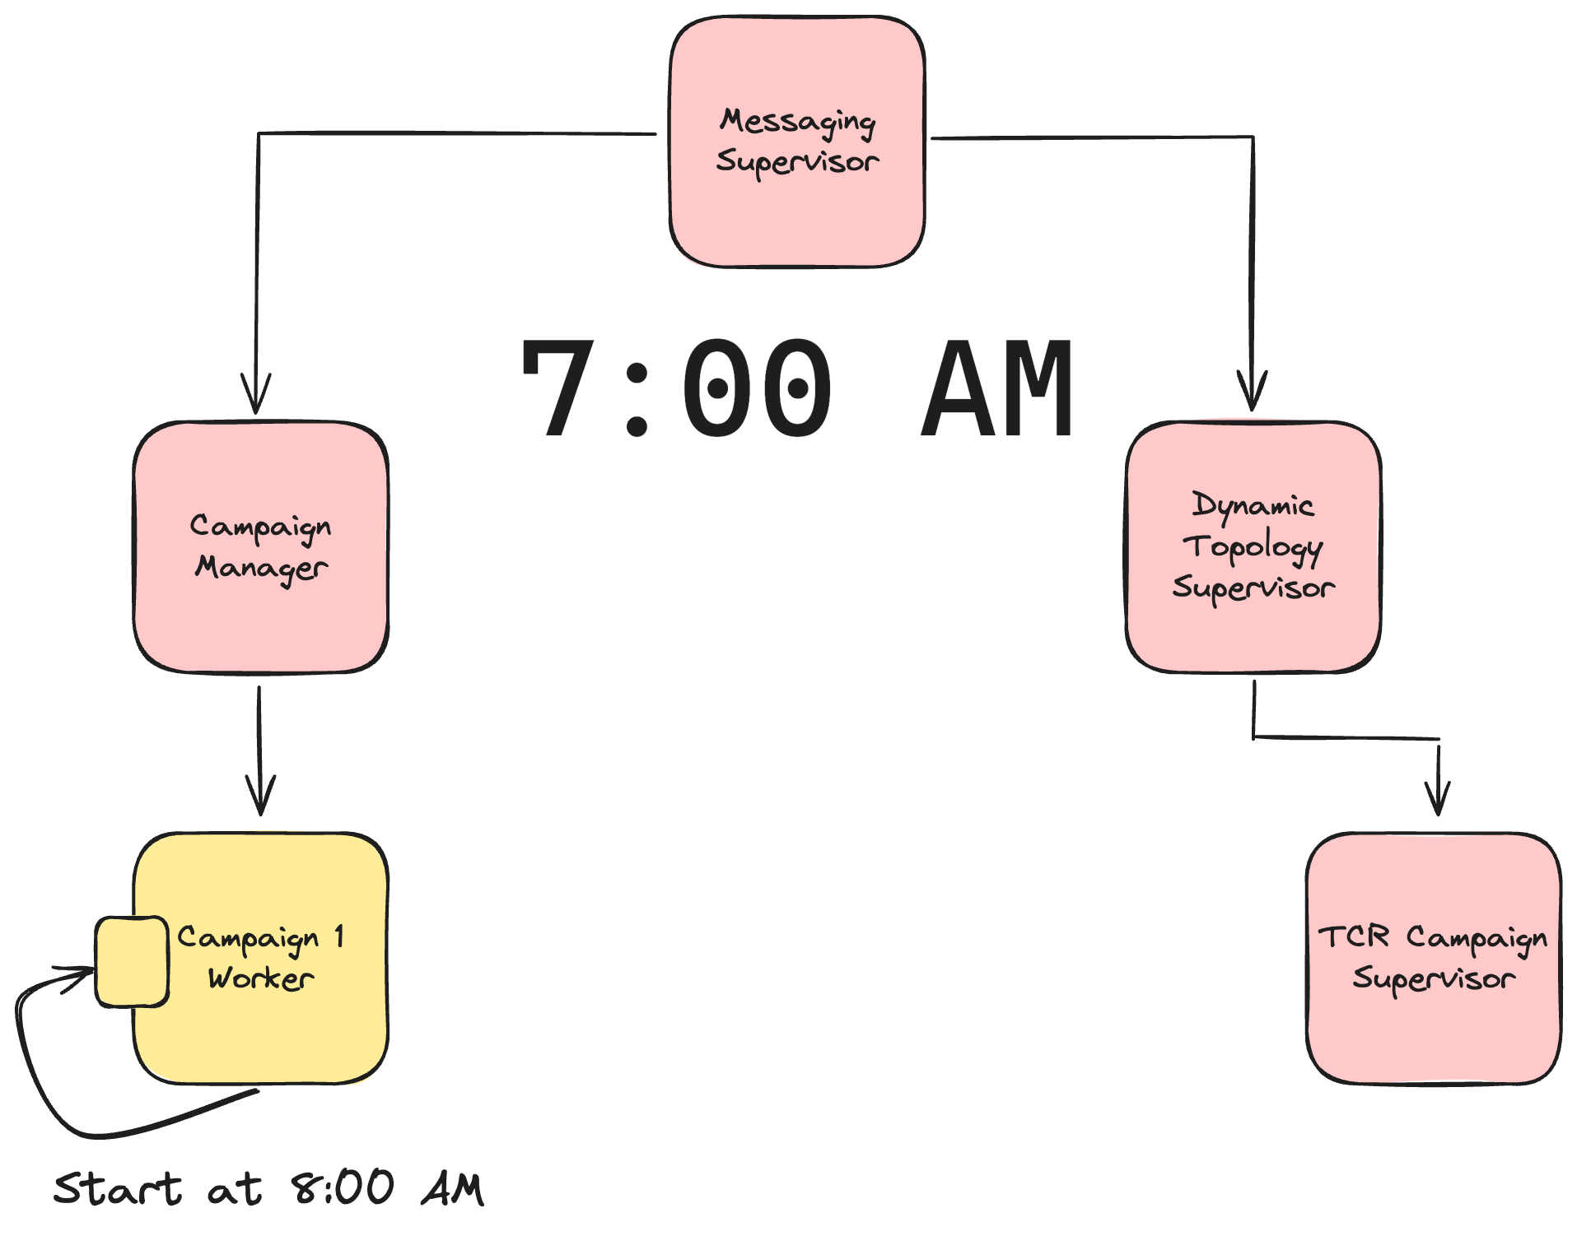
Notes:
Let’s look at a simplified example. Let’s stay we’ve started our application up at 7am and that campaign is scheduled to start at 8am. No consumers have been started for this campaign yet, so no messages will be processed, even if they end up in the campaign’s queue. This is what we want. No messages should be able to go out until the campaign opens at 8 AM.
Campaign 1 schedules a message for itself at 8 AM to start the campaign.

Slide 25
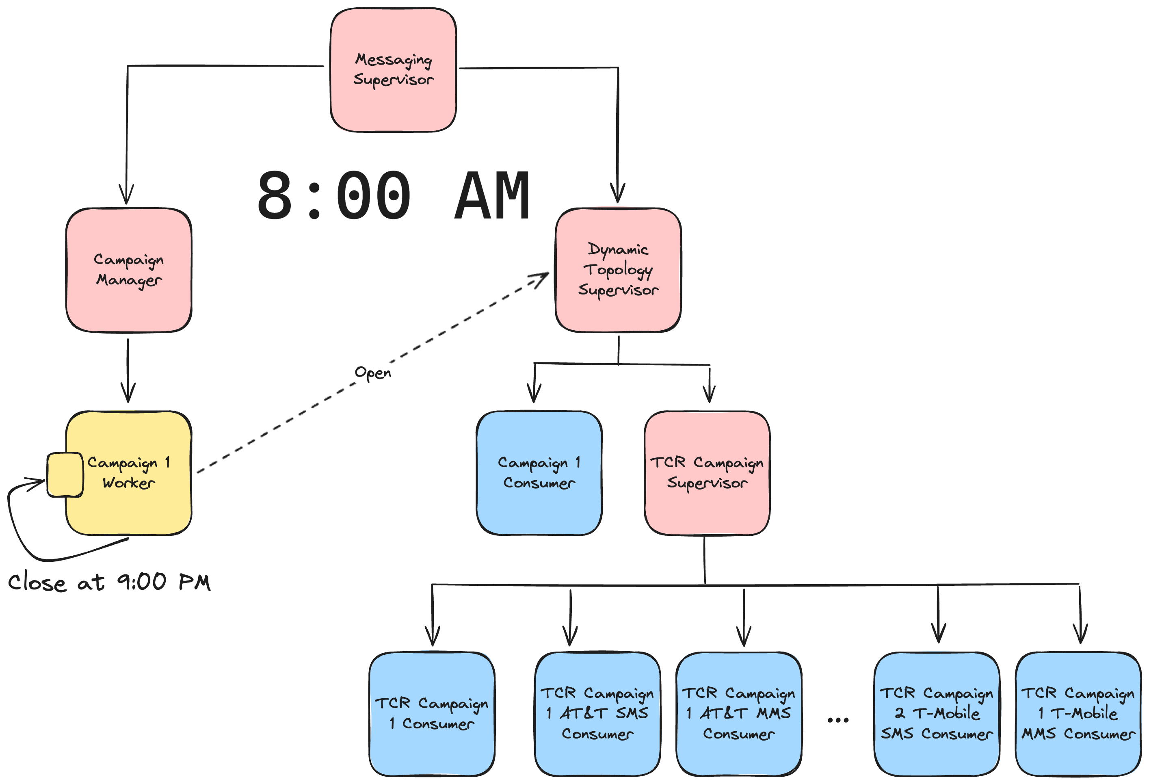
Notes:
8 AM roles around and the message gets delivered to the campaign worker process. This starts all the consumers for the campaign. Once those are started, the campaign worker schedules another messages for itself. This time it’s for 9 PM when the campaign is scheduled to close.

Slide 26

Notes:
9 PM roles around. The close message is delivered to the campaign worker and it shuts down all the consumers. Then it schedules another message for itself to start everything back up at 8 AM the next day.
We had most of that done way back in January. It was time to start some serious QA before rolling it to customers.

Slide 27

QA
Notes:
It did not go well.

Slide 28

Supercollider Repairs
Notes:
What happened? What did we miss? Beyond the normal bugs when implementing a new system, there were a couple of large issues that needed addressed.

Slide 29

UI Issues
Notes:
The first was UI related. We were seeing a number of oddities in the behavior of our UI while developing our pipeline. We kept putting them off though. We thought that they certainly couldn't be a big deal. I mean, the pipeline was completely decoupled from the UI, right? There was no way these UI issues were caused by our new messaging pipeline. Certainly not...
We were wrong. Very wrong.The existing message sending UI didn't handle the new pipeline well. It made a lot of implicit assumptions about latency of data being inserted into the DB that the Super Collider broke.
We ended up declaring tech debt bankruptcy and forked our messenger UI to a new version that only worked with the Super Collider. What we had thought would just be some quick bug fixes, and then thought would be just some changes that broke backwards compatibility with the old messaging system, ended up turning into a full rewrite of the core logic of these UIs

Slide 30

Unexpected Coupling
Notes:
In the long term, this is a good thing. We were able to drastically reduce the DB load that these views had. We used to hit the DB constantly to load new data. Now we optimistically update the UI when sending a message. When a message finally is sent through the Supercollider, we communicate back to the UI through PubSub to confirm that the message was actually sent. We do all of this with very little traffic to our DB. We ended up in a better place, but it was pain that we did not plan for.
Don’t assume that parts of your system are decoupled. Pay attention to those bugs that are creeping in that you can’t explain. They may be pointing to a deeper issue

Slide 31

Broadway Message Weights
Notes:
We ran into one other large issue. We’re supposed to rate limit SMS traffic by segments. Segments are sections of an SMS message.
What we really wanted was a weight on a message so we can say how much it counts toward the rate limit. If a message is 3 segments, we want it to count as 3 towards the rate limit. Then we can continue to rate limit through back pressure.
Unfortunately, this is not supported out of the box with Broadway. We have our own internal fork that adds message weights. For now, we’re maintaining this fork ourselves. We’re not sure if it’s something that makes sense in the core Broadway Rabbit producer.

Slide 32

Notes:
That was a quick overview of our domain and some lessons learned before launch. If you want a more thorough breakdown, I encourage you to check out a previous version of this talk that I gave at Stir Trek back in May before the we had started rolling the system out. That QR code will take you right there and it will be linked to in the repo I'll share at the end of the talk.

Slide 33

Broadway & Rabbit In Anger
Notes:
The real learning starts though when you start using a system in anger.
Back in May we turned on the system for just a few customers to kick the tires on it in prod. That went well. We found a few bugs and quickly fixed them. Our customers were finally sending messages through the Super Collider! Things were great.
Then it was time to turn it on for the first full release group. I was on vacation, relaxing in the mountains of Tennessee, completely disconnected from work. Little did I know that my co-workers were dealing with our first incident.

Slide 34

Act I: The Pooling
Notes:
One of the advantages of working in a domain where the system is unused at certain hours is that you have convenient release windows. We decided to take advantage of this to turn on the first release group in the middle of the night.
We clicked the button and Rabbit immediately became unresponsive. Our error monitoring spammed Slack with so many messages that Slack became unusable. Rolling back the release group and getting the system stable again took a few hours. What happened?
The issue turned out to be something we had noticed, but not taken seriously.

Slide 35
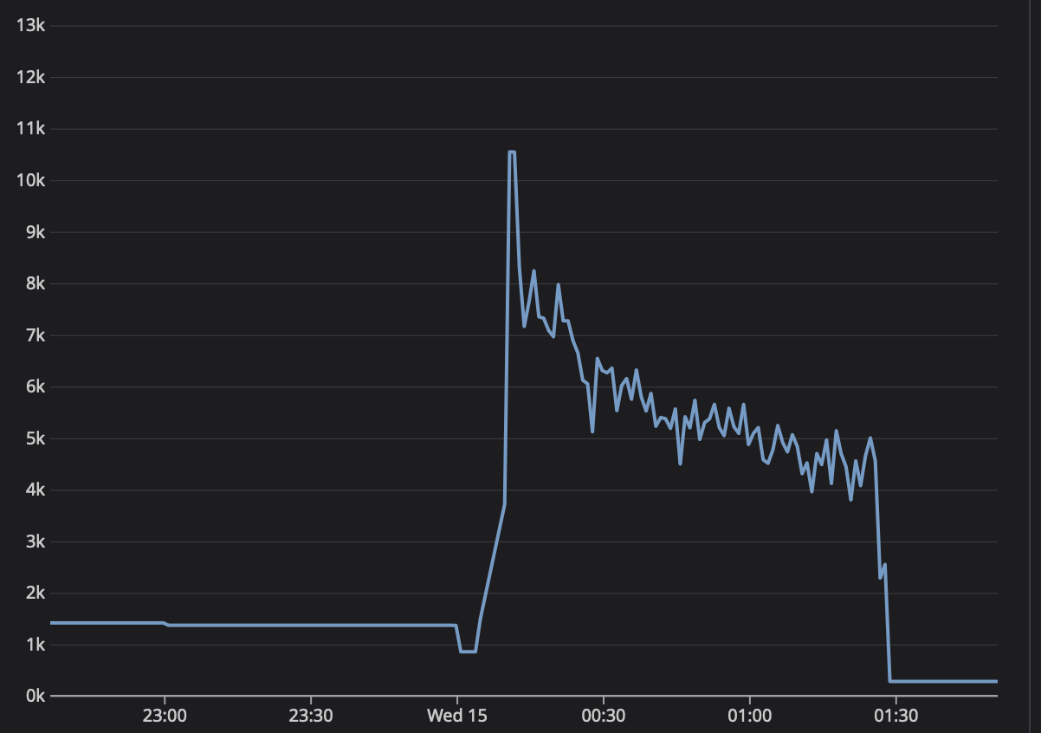
Notes:
And that is how you get a chart like this showing your Rabbit connections

Slide 36
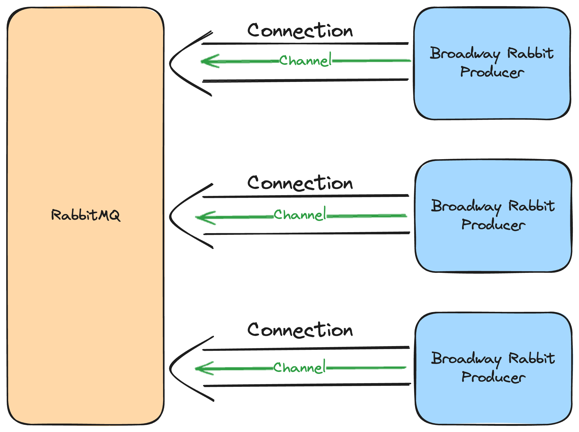
Notes:
We were seeing a 1-to-1 relationship between connections and channels on Rabbit. This is the default behavior of the Broadway RabbitMQ producer. Every producer creates a new connection to Rabbit and opens a single channel on that connection to manage consuming messages from a queue.
This works ok for apps with a limited number of consumers. It is not fine for an app with thousands of consumers. A 1-to-1 ratio of connections to channels is violates the RabbitMQ recommendation to create few connections with many channels.
We attempted to create almost 12K Broadway consumers. That means we attempted to create almost 12K connections to our poor Rabbit cluster.

Slide 37

Use a Custom Broadway
Connection Pool
Notes:
The good news is that the Broadway RabbitMQ producer allows you to pass in your own implementation of the Broadway.RabbitMQ.ChannelPool behaviour.

Slide 38

Notes:
When configuring the consumer on your Broadway producer, you can pass in configuration for a custom pool.

Slide 39
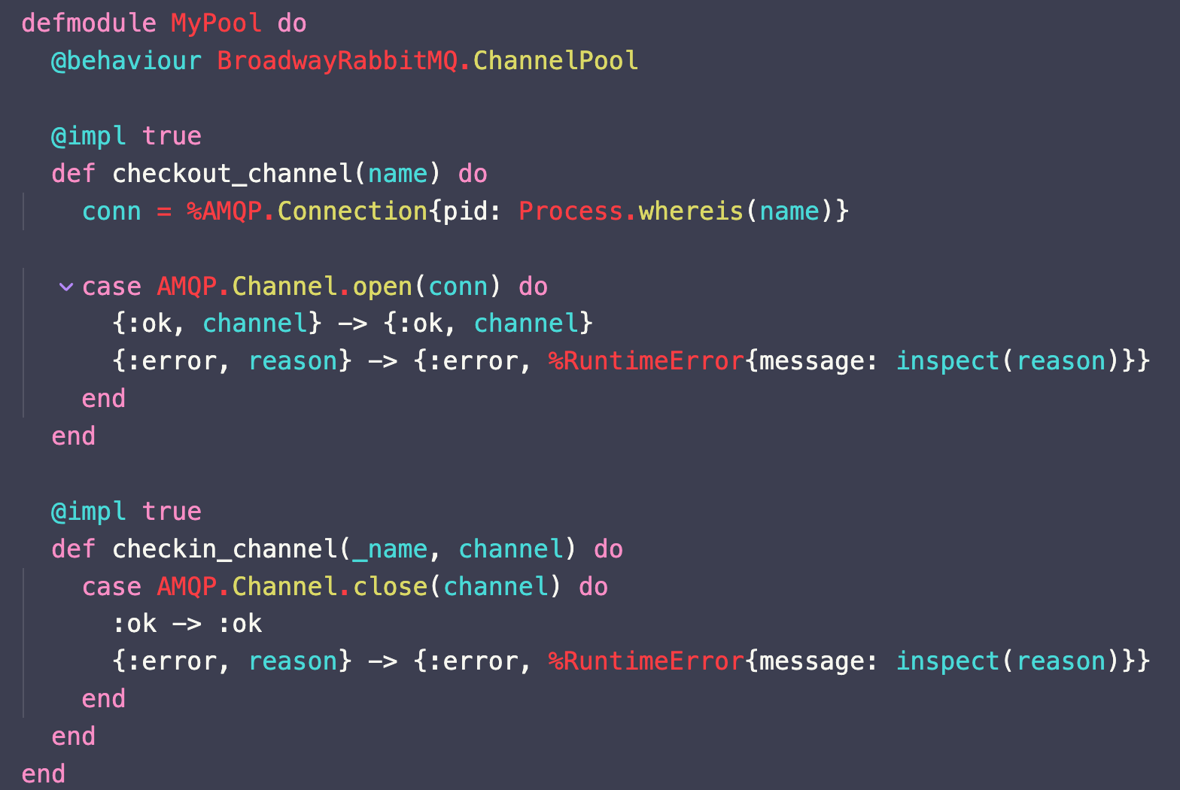
Notes:
This is an example implementation of the behaviour from the docs. You can see there are only two callbacks to implement, checkout_channel and checkin_channel.
There are some existing libraries out there, but we decided to roll our own fix.

Slide 40
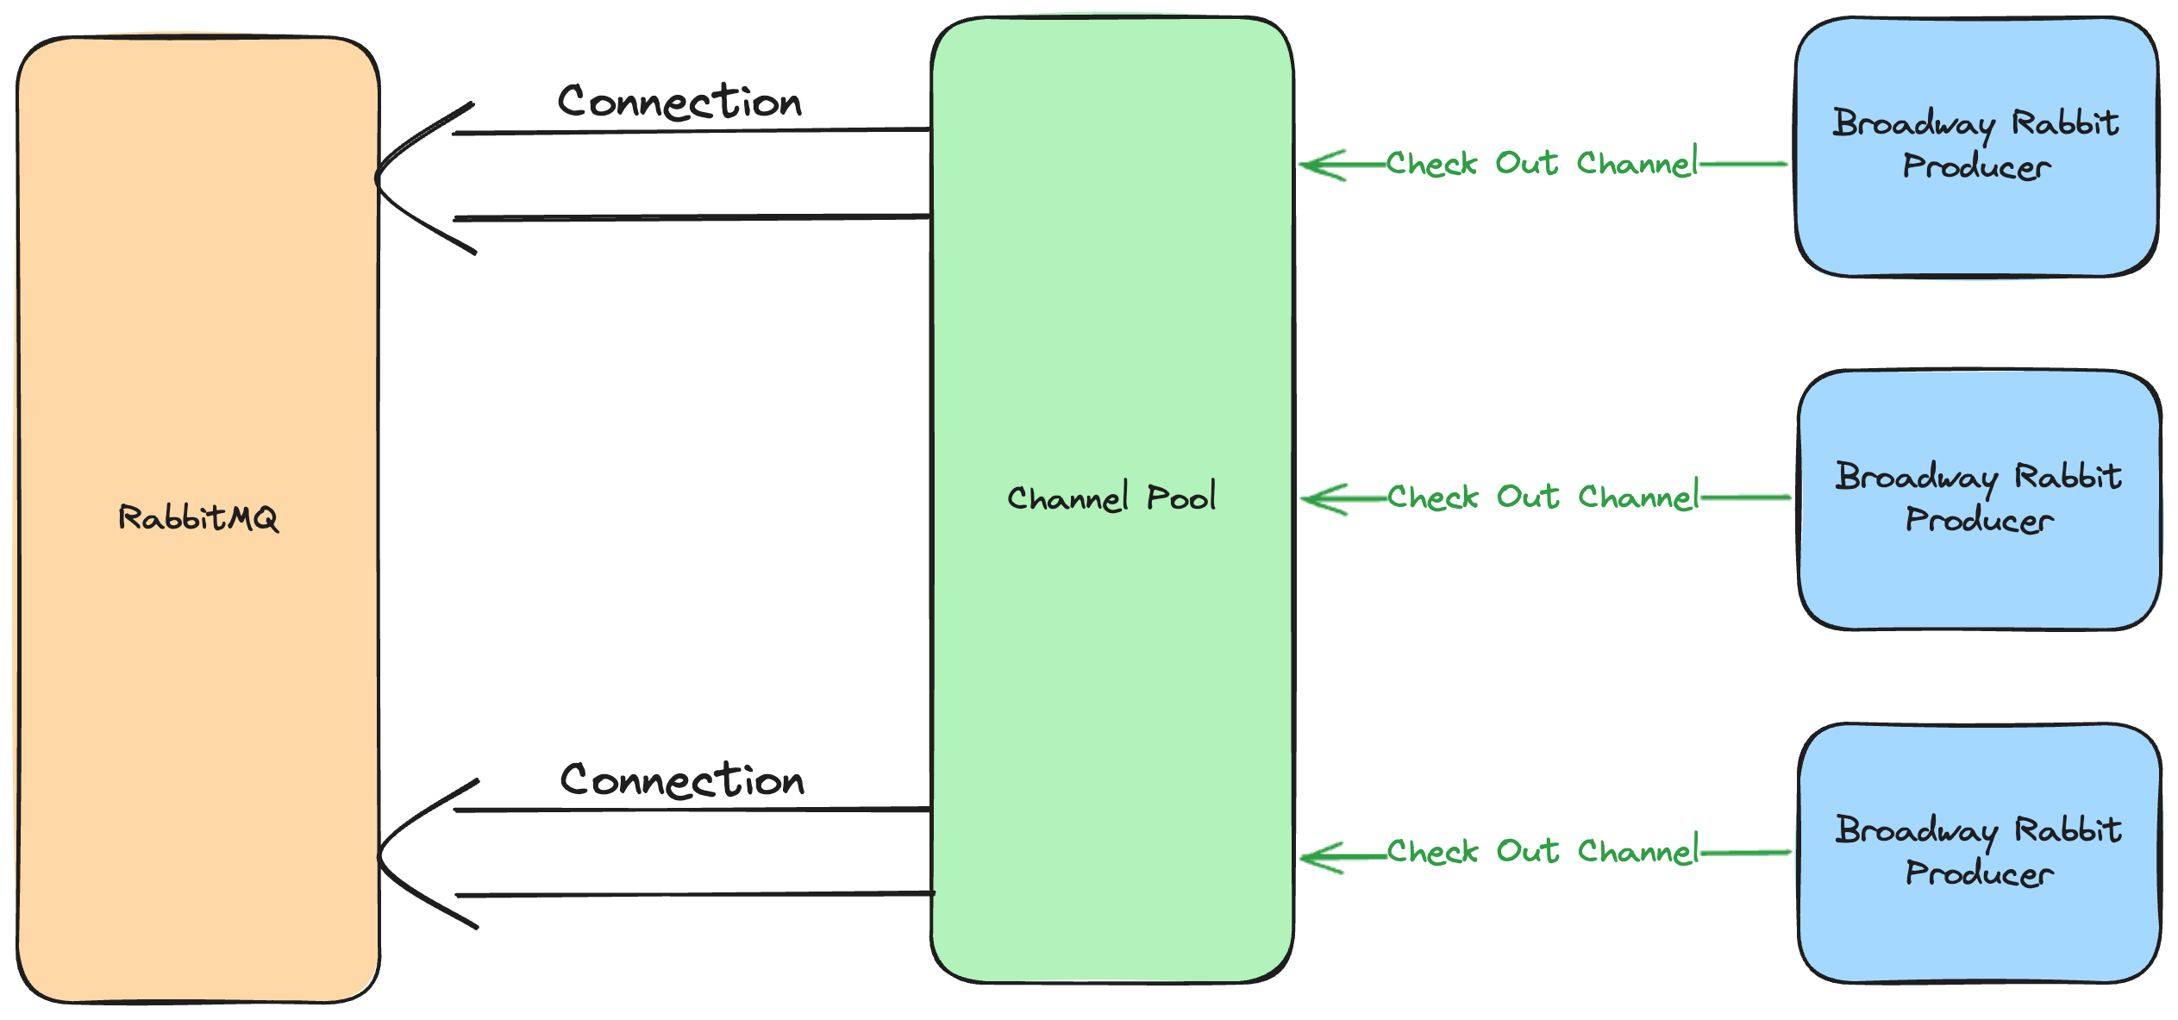
Notes:
On application startup, we create a connection to Rabbit for each BEAM scheduler. By default, there are two schedulers per core. This example shows the situation on a one core machine. When checking out a channel, each producer gets the connection for its scheduler and then opens a channel.

Slide 41
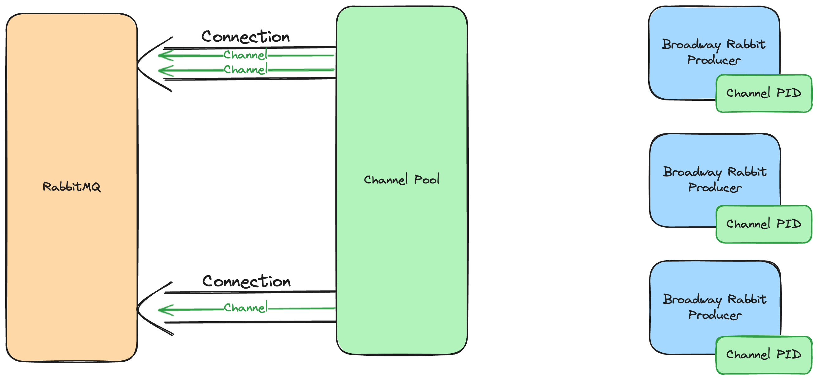
Notes:
There are three channels have been opened across the two connections, one for each producer. Each producer now has access to a channel

Slide 42
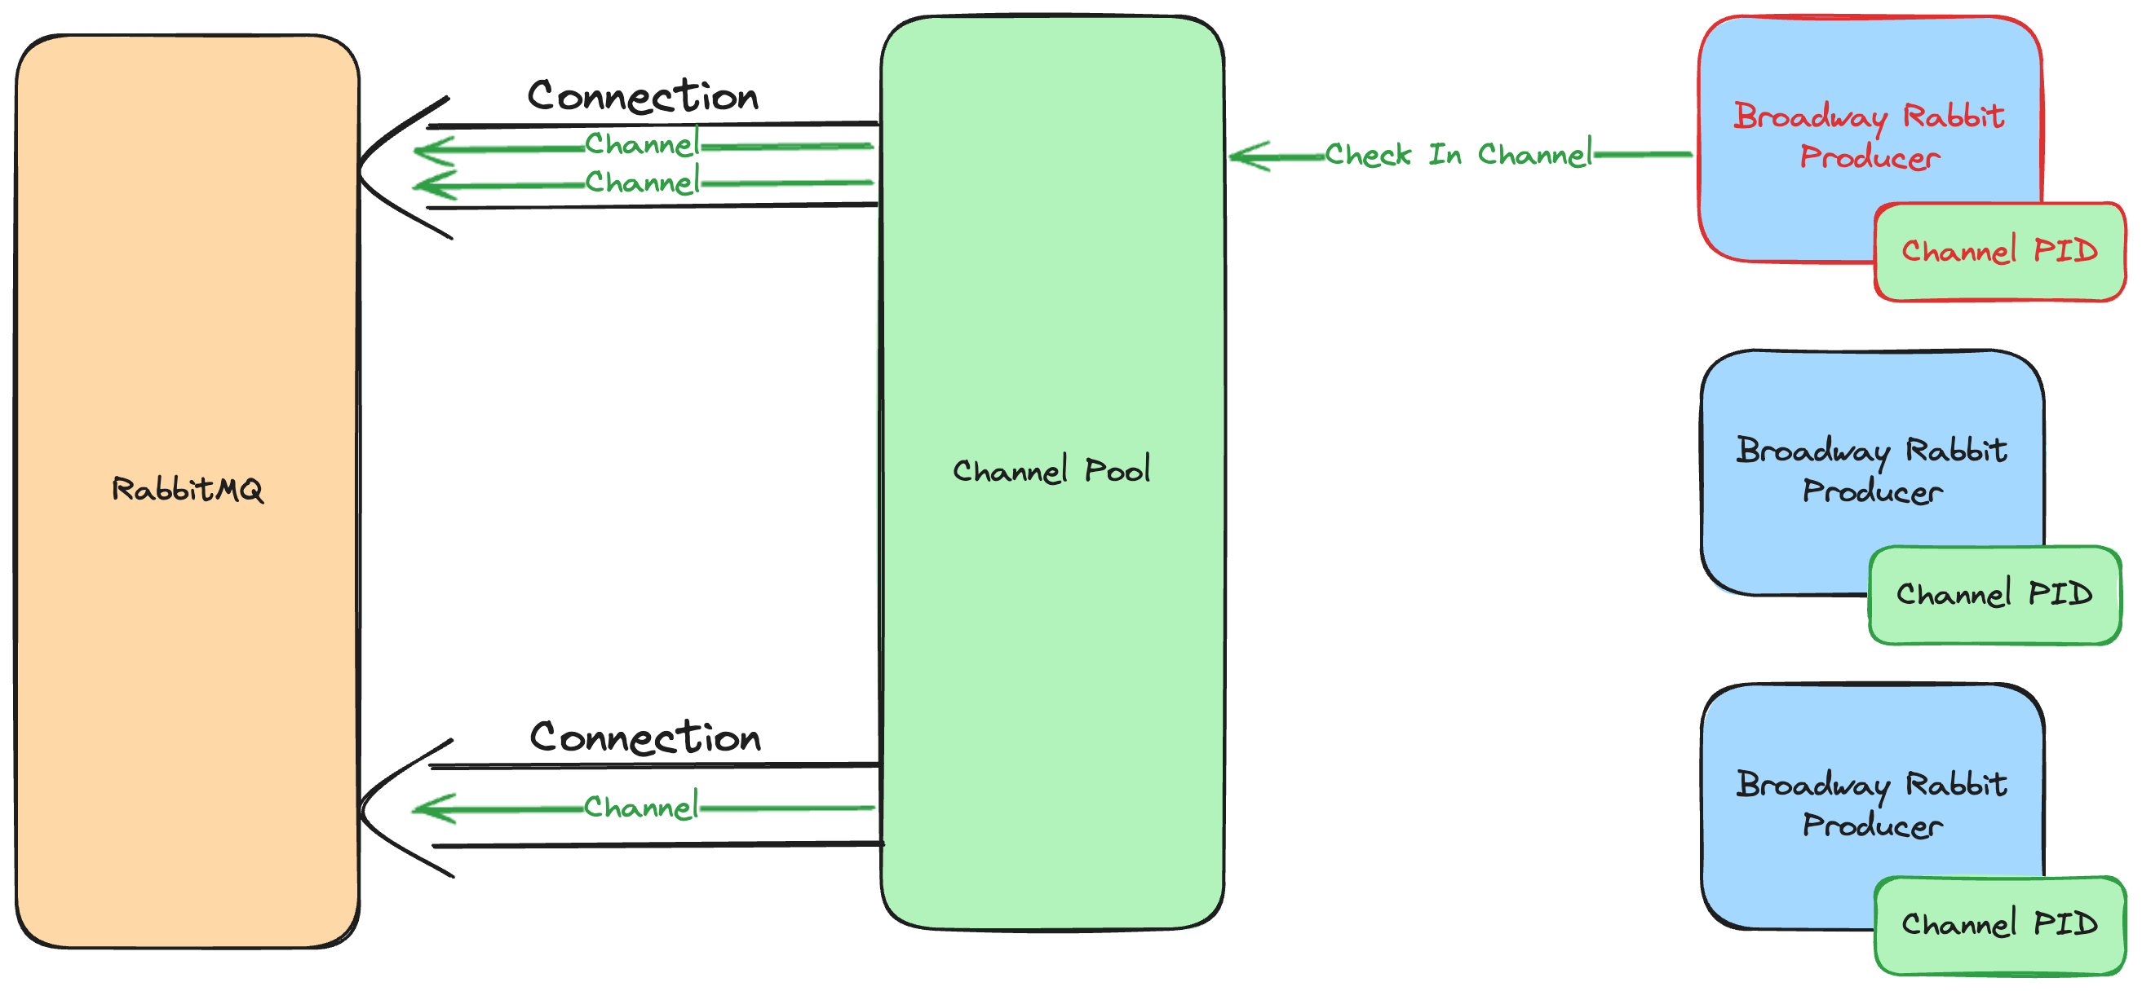
Notes:
When a producer closes, it attempts to check the channel in.

Slide 43
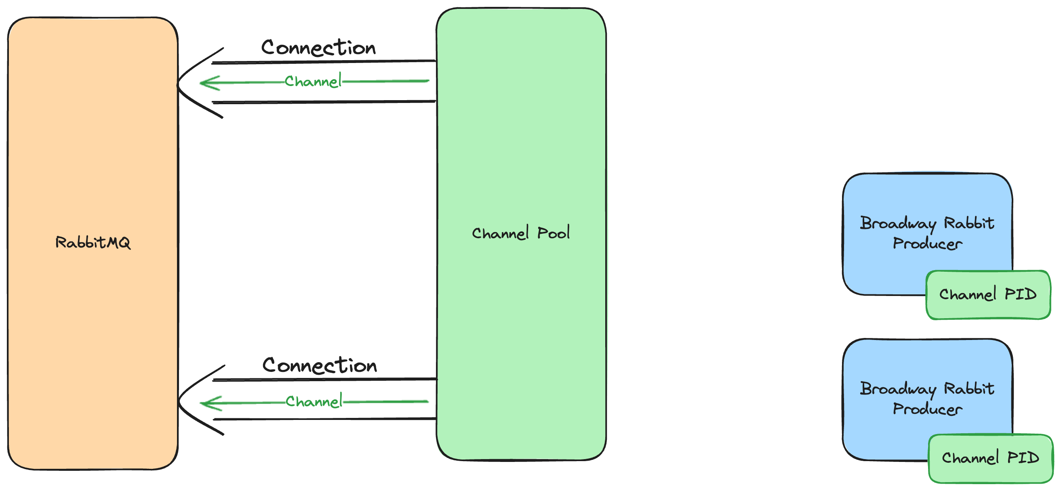
Notes:
The producer is closed and the channel has been closed. The underlying connection still exists.
This is working well for us. This fix allowed us to turn the Super Collider on successfully for the first release group, but it also showed the need for one other tweak.

Slide 44

Avoid the Thundering Herd
Notes:
Elixir is great at spinning up thousands of processes in a very short amount of time. However, when turning on the Super Collider for the first time in each release group, we quickly realized we needed to throttle how fast the consumers were being created.
Broadway consumers will create the queue if it does not exist. Without throttling, we attempted to create thousands of queues in Rabbit all at once. This is a one-time hit the first time a release group is turned on, but it spiked Rabbit resource usage enough to spook us.
Don’t be the thundering herd. Processes are cheap to spin up, but think through what systems those processes are all talking to.

Slide 45

Hosting Matters
Notes:
Even before this incident, we had not been happy with AWS’s RabbitMQ offering, Amazon MQ. It didn’t give us the kind of observability we needed. It severely limits how you can get metrics out in a way that doesn’t bloat your AWS bill.
They don’t support the Rabbit Prometheus plugin and want you to query Cloudwatch logs instead.
This is not an advertisement, but we ended up switching to CloudAMQP. Now we get all the metrics we want into Datadog. In addition, it’s been easier to get ahold of somebody when something goes wrong. Such as opening so many connections that your server becomes completely unresponsive.
After making those fixes, we were able to successfully turn on the Super Collider for our first release group. While we didn’t run into any large incidents again with this release group, we did have a number of smaller issues to address.

Slide 46

Unrouted Message Handling
Notes:
First, we would occasionally get unrouted messages. The campaign and carrier queues in our system are dynamic. If something went wrong when creating that queue and we didn’t catch it, sending messages to that queue didn’t fail in the way we expected.
We had expected that setting the `mandatory` flag when publishing a message would cause an error to be returned if the queue did not exist. What actually happens is that Rabbit sends a `basic.return` command back on the channel.

Slide 47
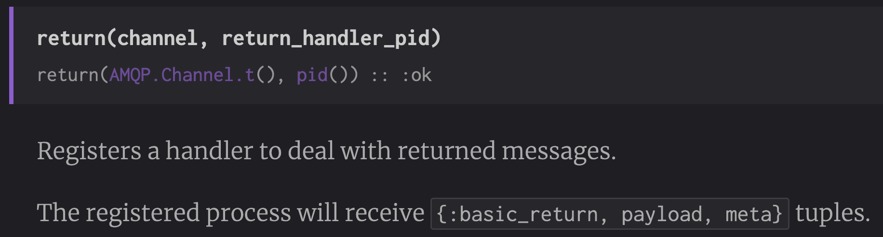
Notes:
AMQP lets you register a handler for this. The problem is that our code expected this to return an error. Publishing with the mandatory flag to a non-existent queue returns `:ok` and then the return handler gets called if you've registered one.

Slide 48
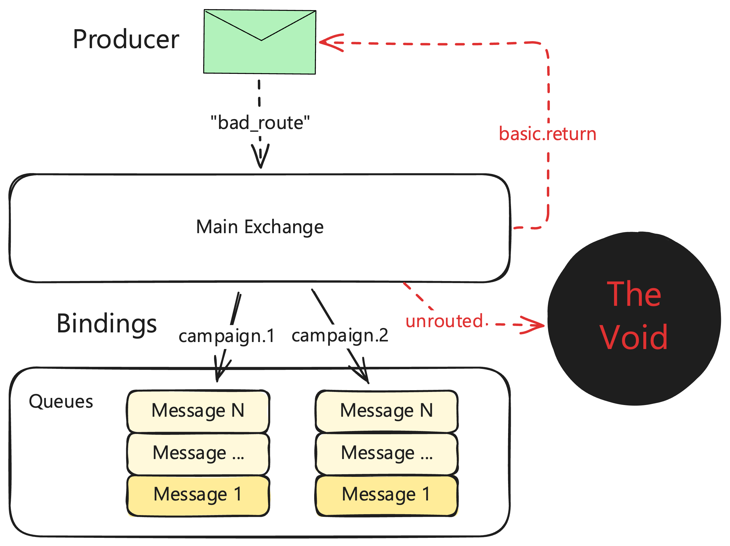
Notes:
This shows the default behavior. There is a Rabbbit exchange, a couple of queues, and a couple of bindings. When a message gets sent to the exchange with a routing key of “bad_route”, none of the bindings match, so Rabbit doesn’t route it to any queues. It just drops into the void and sends a basic.return message back to the producer.
Instead of implementing this handler and dealing with what is now an asynchronous publish operation, we went with a solution in Rabbit itself.

Slide 49
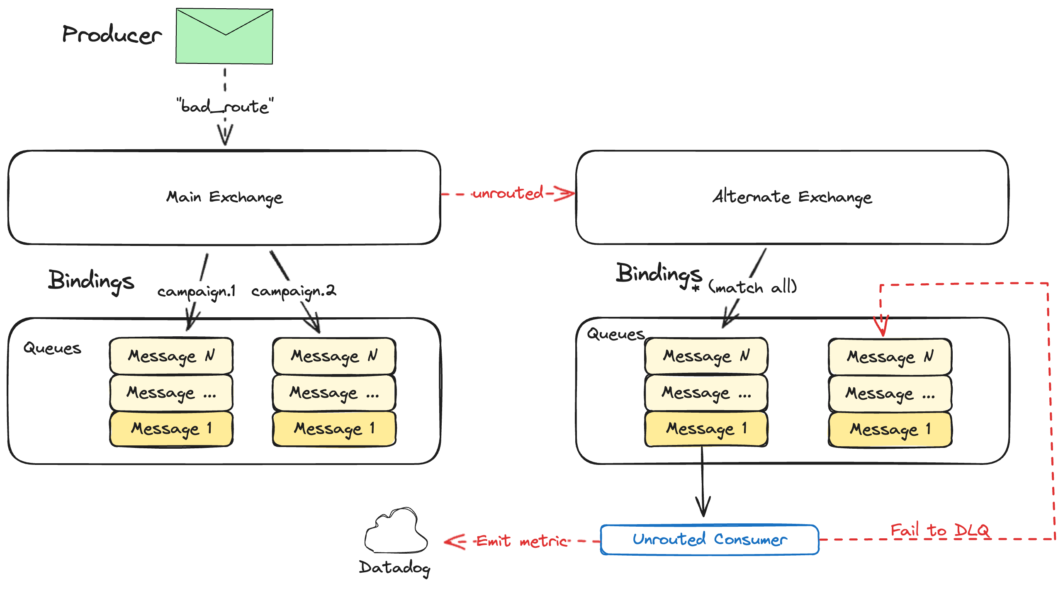
Notes:
Rabbit allows you to create what is known as an "alternate exchange". If you send a message to an exchange and no bindings exist to handle that message, then it will get sent to the alternate exchange instead.
Our alternate exchange is dumb. It is a fanout exchange with one binding to a `text.unrouted` queue. We have a consumer that watches this queue for messages. It consumes the messages, emits a metric letting us know there was an unrouted message and then marks it as failed so it gets sent to a DLQ.
Now, in the rare event that we get an unrouted message, a monitor in Datadog pages us and we can intervene as needed. This usually means creating the missing queue, shoveling the messages to the new queue, and then debugging why the queue didn't exist in the first place.

Slide 50

Limit Telemetry
Notes:
OpenTelemetry is great. We send a ton of telemetry to Datadog. But it isn't free, both in dollars and processing time. It's a terrible feeling to see your system melting down and your dashboards stop working because you're sending so much telemetry that your Datadog agent can't keep up. During one incident we logged ~1M messages in a 15 minute window. This overwhelmed our poor Datadog agents and risked our metrics becoming inaccurate or stale.
But even in a non-pathological case we knew our telemetry was unsustainable and had been turning it down. During development and the initial rollout, we kept logging and traces high, but we had started turning that down as traffic ramped up.
We also know that our traffic is very bursty. A very common usage pattern for us is low traffic with spikes as a customer launches a large campaign and sends all of their initial messages. That means we can get lag in our DD agents when they get a burst of traffic.

Slide 51

Notes:
Between bursts and error states, you need to keep your worst case scenario in mind for telemetry. How is your telemetry going to perform under pressure?

Slide 52

Rate Limit Getting Your Rate Limits
Notes:
We get rate limits for some carriers from TCR. These rate limits can vary depending on a number of factors. In response to certain events from TCR, we need to call their API to get the latest rate limits for a TCR campaign.

Slide 53
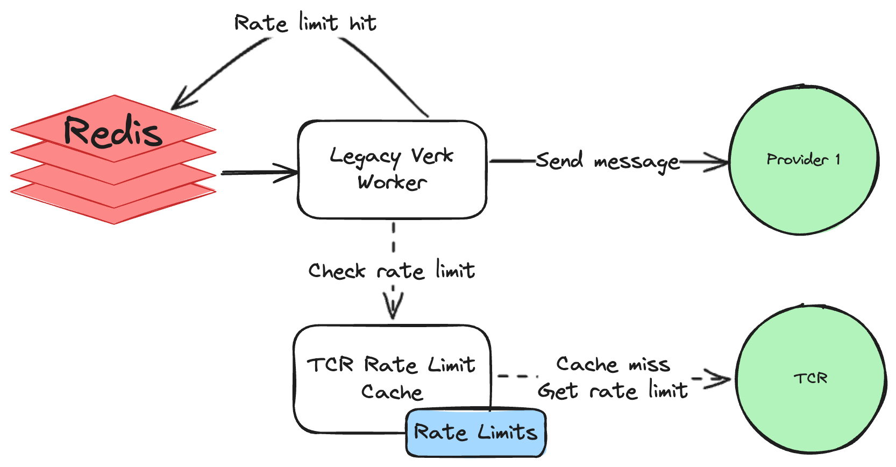
Notes:
The issue is that the TCR API has its own rate limit. The legacy system would check a cache when sending a message. If the rate limits for that TCR campaign were not cached yet, we would make an API call to TCR to get the rate limits for the TCR campaign. They would get added to the cache with a TTL of 15 minutes. Why this was so short remains a mystery to this day. These rate limits almost never change.
Anyways, we didn't realize how this cache worked when we deployed the SC. We knew there was a cache for TCR rate limits and we started using it.

Slide 54
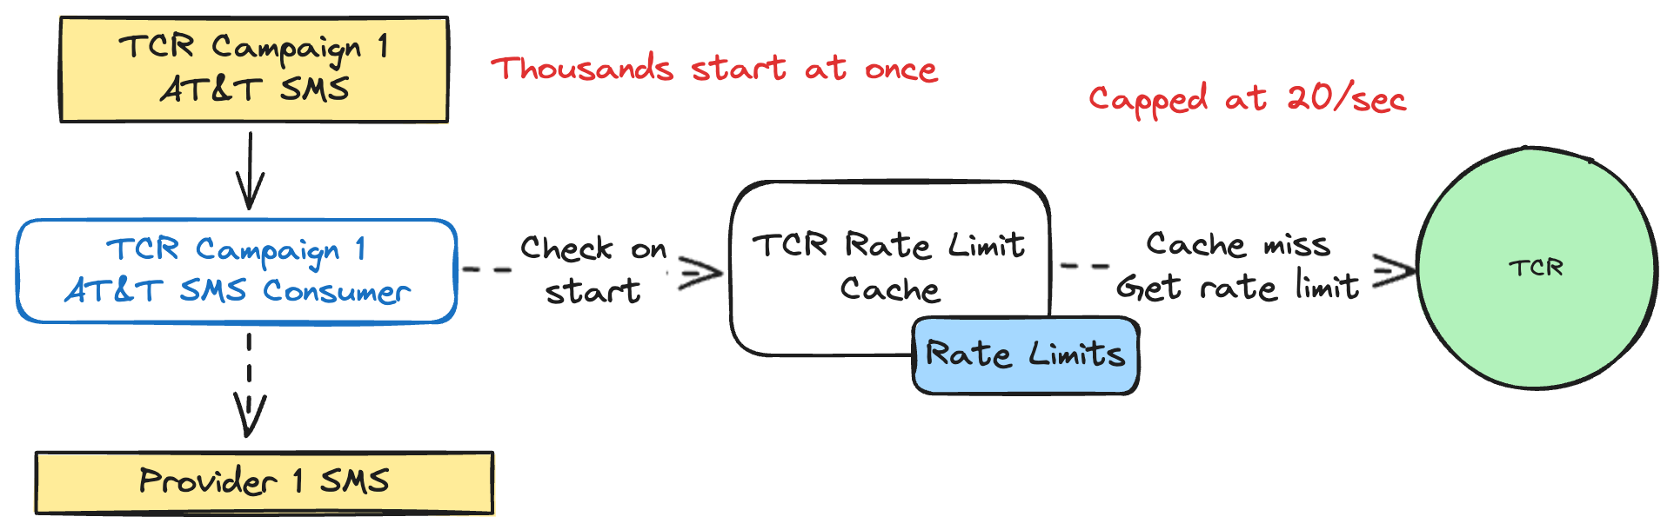
Notes:
The problem was that our usage of this cache was wildly different than the legacy system. On application boot, we start many TCR consumers. Every single one checked the cache for its rate limit, but nothing was cached yet. As campaigns opened, the hit rate was low because of the low TTL. On cache misses, we made an API call to TCR.
That’s all fine. The problem is that the TCR API rate limit is 20 calls/second. Our usage patterns had changed and we were blowing past this rate limit.
The cache had made another choice that didn't work well for our new use case. When the rate limit was exceeded, instead of failing it would return a fallback rate limit for each carrier. And it would do that silently. It wasn't clear that we were falling back to a default. In practice, this meant that one node in our cluster might get the correct rate limit from TCR, but all the other nodes would get rate limited and use the fallback.
Fixing this was an unexpected side quest. It was wild and unexpected though that we got burned by a rate limit getting our rate limits. We now store these in our DB and only update them when necessary. We don't hit their API all the time anymore.
Caching is great, but you need to understand your caching if your usage of it changes wildly. Was that cache making assumptions that no longer apply?

Slide 55

Dangers of Immediate ACKs
Notes:
While trying to fight another issue with duplicate text messages being sent, we started immediately ACKing messages in each Broadway consumer. This had an unfortunate side effect that caused us to rollback the change.
It turns out that you can’t fail the message after it’s been ACK’d. When you say it out loud, that makes sense. You’ve told Rabbit that you’re handling the message and that it doesn’t have to care about it anymore. We only realized the problem when we saw that messages in retry queues were not going to the DLQ after failing too many times. The messages just disappeared even though we had marked them as failed.
Luckily, we realized this relatively quickly and found different ways to deal with duplicate message sending.

Slide 56

Static Retry Queues
Notes:
Retry queues have been a recurring focus for us

Slide 57
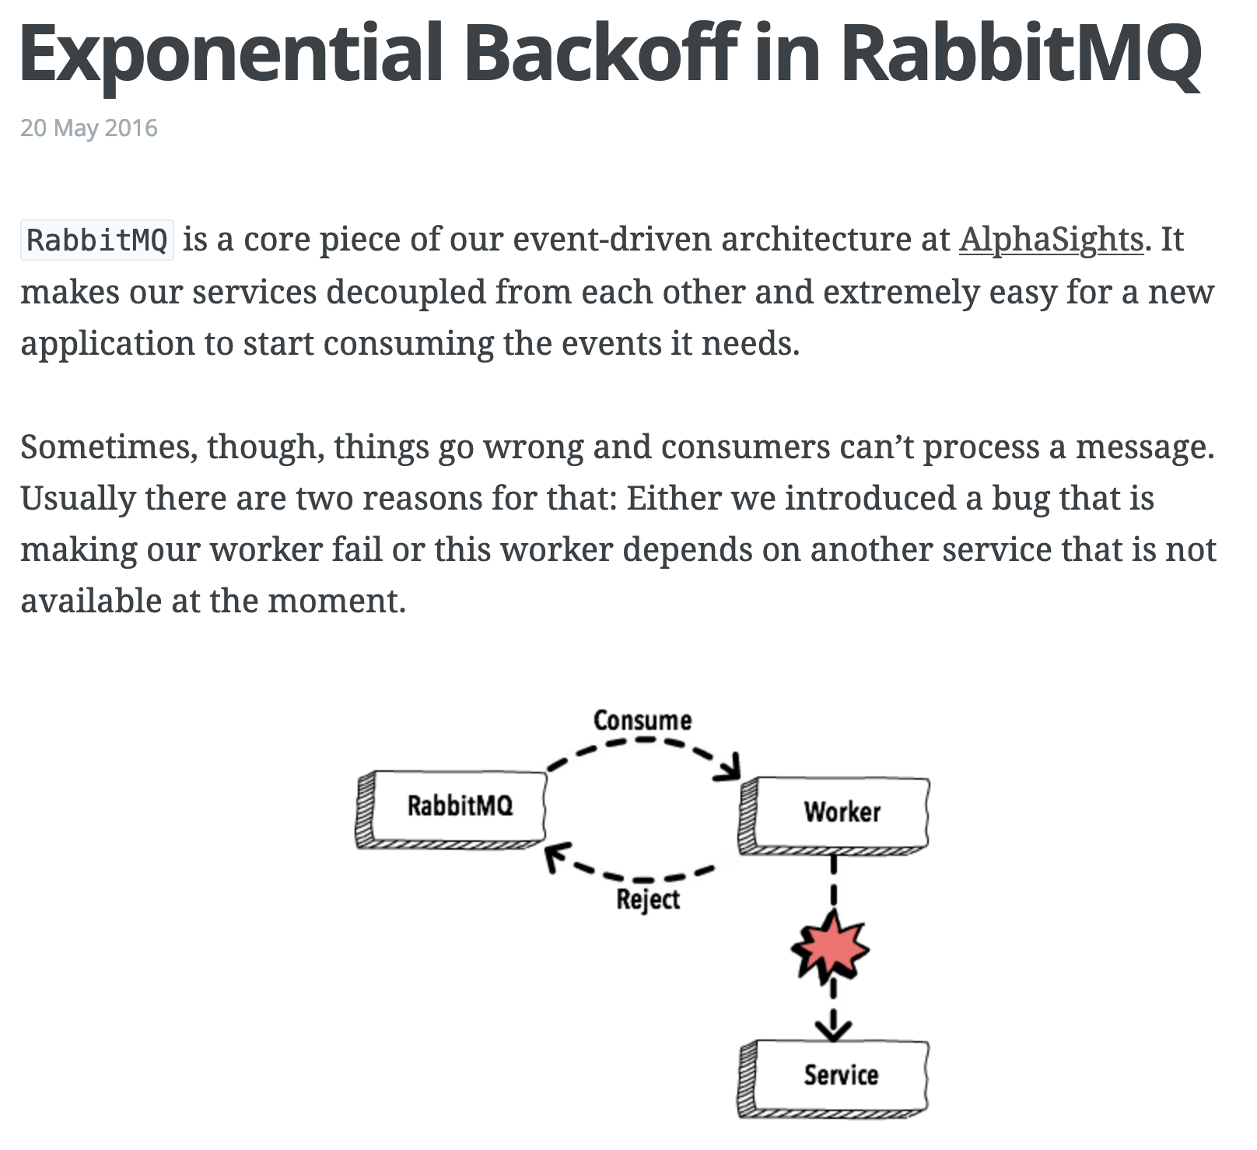

https://www.brianstorti.com/rabbitmq-exponential-backoff
Notes:
Our retry strategy is based on this article by Brian Storti. If you're building an event or message-driven system with a lot of retries, then read this article.

Slide 58
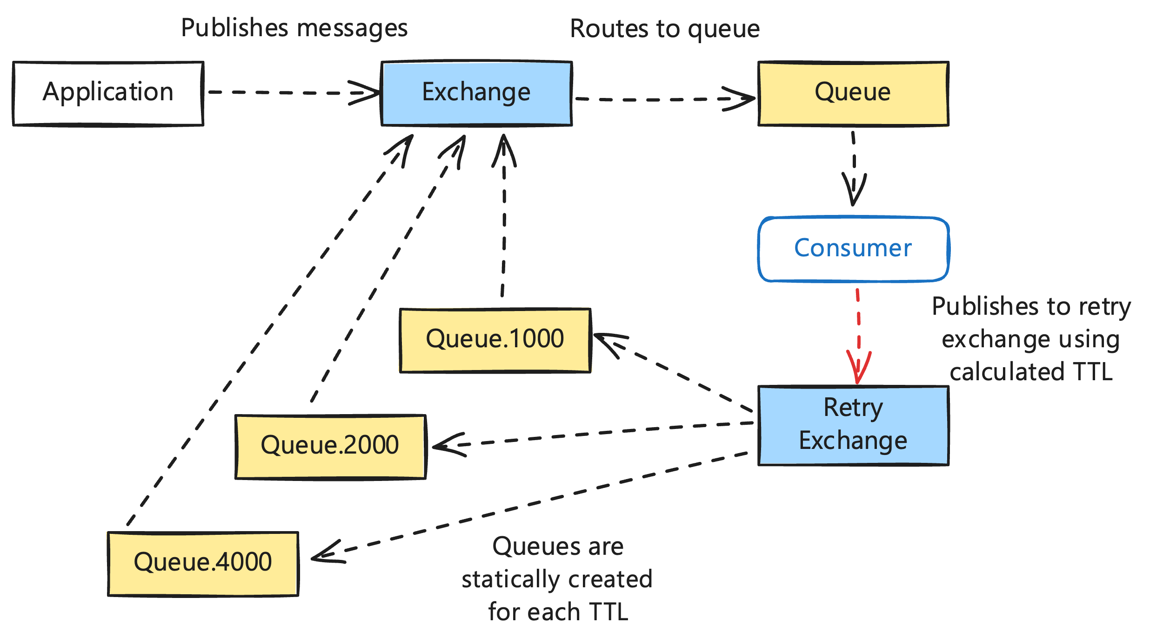
Notes:
This is where we ended up. The application publishes message to the exchange, which get routed to a queue. A Broadway consumer processes those messages and something goes wrong. It publishes to a retry exchange. Based on how many times the message has failed, the message goes to a retry queue where every message has the same Time To Live. This is important because Rabbit messages in a queue can only expire in order. If every message in the queue has the same TTL length, then they will expire in order.
When the TTL expires in each retry queue, the message is sent back to our original exchange and routed again for retry. We made some mistakes in getting here though.
First, we were dynamically creating companion retry queues for each queue in our system. That was unnecessary.
Dynamic retry queues risk an explosion of queues in a worst-case scenario. If an incident causes messages to start retrying across many campaigns, all of a sudden we're creating many more queues. This risks cascading failures. If an incident creates so many retry queues that Rabbit performance degrades, then we're in for a world of pain.
Most of the retries use exponential backoff. We have a set of 10 static retry queues, one for each attempt. All messages in the first retry queue have the same TTL. So do the second and so on. When the TTL expires, the message gets routed back to its origin queue according to it's routing key through the main Rabbit exchange.
This gives us a static amount of resource usage and eliminates any issues with dynamic queue creation for retries.
For domain reasons, T-Mobile retries are special. T-Mobile has a daily cap instead of a per minute or second rate limit. Once the daily cap is hit, very message for that TCR campaign get sent to a T-Mobile retry queue with a TTL of midnight PT. Once again, no dynamic queue creation needed.
This also fixed a bug where queue TTL didn't work as we expected. We had misread the docs and thought that a queue TTL would reset when a message was published to it. This is wrong. Queue TTLs only reset when a consumer connects. And since our retry queues never have a consumer connect to them, that meant their TTL never reset. Depending on the timing of when messages were added to the queue, this meant we were losing some messages in retry queues when the queue expired.

Slide 59

Act II: The Channeling
Notes:
After addressing the main connection and channel issues in the first incident, we had continued to roll out the Super Collider to more release groups. The next-to-last release group added a decent amount of load to Rabbit, but we thought we were fine.
We knew from our monitoring that our memory usage on Rabbit was a bit high, but it was tolerable. Unfortunately, what we did not have good monitoring on was our CPU usage. One morning after an unrelated deployment, we noticed that messages had stopped sending about 10 minutes ago. Then we got paged.

Slide 60
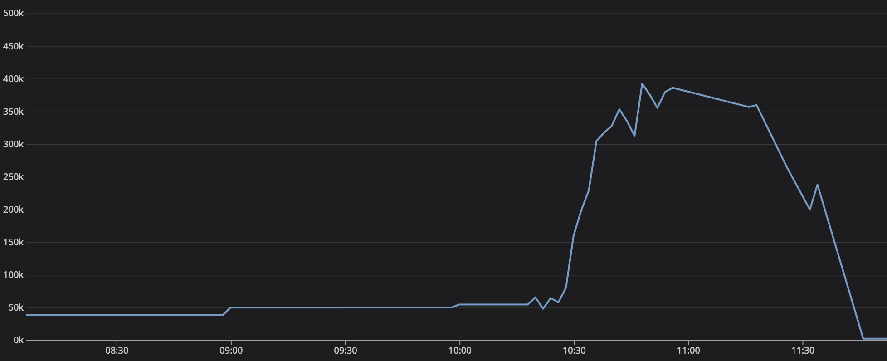
Notes:
The system was crumbling before our very eyes. We had gone from our steady state of ~60K channels in Rabbit all the way up to 400K.

Slide 61
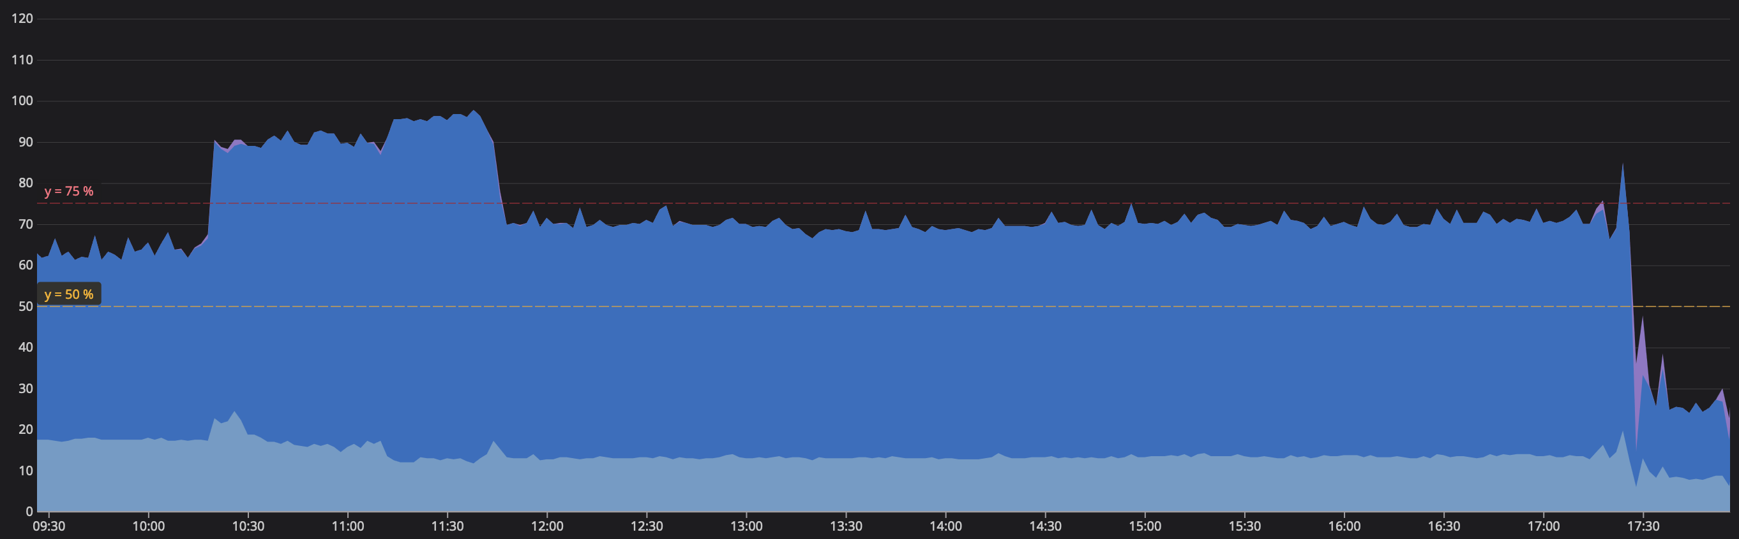
Notes:
Our CPU usage on every Rabbit node in the cluster was pegged at 100%. Memory was using a large amount of swap. We were unable to get the system under control and started disabling the Super Collider for each release group to try and recover. This rolled customers back to our legacy system so they could continue to send messages while we surveyed the wreckage.

Slide 62

Notes:
I mentioned earlier that CloudAMQP support is great. This was one of those times when they had to restart our servers for us.
To our best knowledge, this is what happened. We do blue-green deployments. We spin up a few new nodes, wait for them to be healthy, and then shut down the old nodes. This means that on each deployment our system has more nodes than usual for a brief period of time. We had not taken this into account when evaluating our Rabbit resource usage. We were flying too close to the sun and deployments pushed us over the edge.
With Rabbit pegged at 100% CPU usage, we think that channels became unresponsive. In response, the Broadway Rabbit producer checked out new channels. This led to a catastrophic rise in channels from 60K -> 400K.
This incident was embarrassing to say the least. We had some customers not have their text messages get sent out. We hadn’t understood the behavior of our system well enough to head off what should have been an obvious risk. We had been watching memory usage all week and thought we were fine. We were not. In addition to code changes, we increased the size of each node in our Rabbit cluster to give ourselves more head room going forward.
The good news is that all traffic was now back on the legacy system, so we had an opportunity to do some invasive fixes that would have been more difficult if we had to worry about in-flight messages.

Slide 63

DLQs and Memory Usage
Notes:
One way to deal with our resource usage was to look at the sheer number of DLQs that we had in our system.

Slide 64
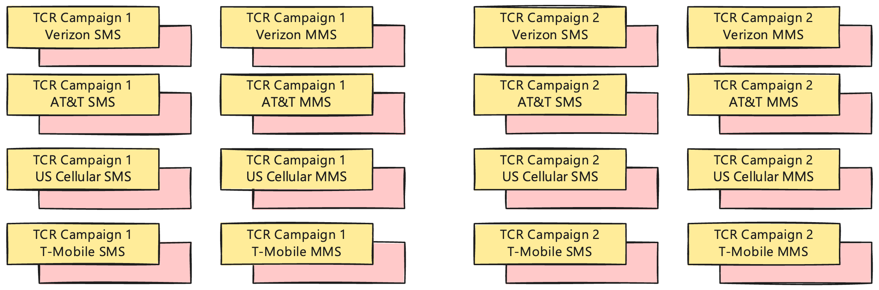
Notes:
Every single campaign queue had it's own DLQ. Every single carrier queue also had it's own DLQ. Before we deployed, we thought this was going to be fine. We had benchmarked how much memory a queue uses at rest.
Unfortunately, we hadn't accounted for the overhead of running in a cluster and the overhead of switching to quorum queues. We benchmarked on classic queues, but switched to quorum queues at some point. We didn't benchmark again. We should have.
Looking into the wreckage of this, we saw that our queues were using more resources than expected; at least twice as much. And we hadn't accounted for the CPU usage of these queues at all. We should have realized that would be a thing. Each queue seems to spin up a couple of Erlang processes and that takes some resources, even without traffic flowing through them

Slide 65
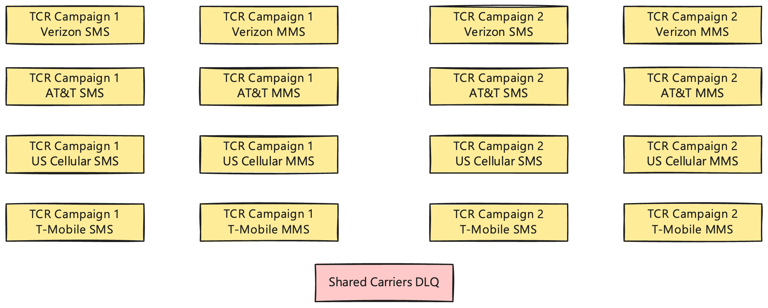
Notes:
Now that the system was shutoff, we took the opportunity to consolidate our DLQs. All campaigns now use the same DLQ. Her we can see that all TCR campaign carrier queues also use the same DLQ. We went from 10's of thousands of DLQs down to 2 for these stages.
The downside here is that we can't blindly shovel messages back and forth. Each DLQ now has messages from many different queues. This was pretty easily solved with our own shovel tool though. Every message still has the original routing key. We just pull each message off the queue and publish it back with the original routing key.
And honestly, the interface we put together is way nicer than the generic interface in the RabbitMQ Management Plugin. The sheer number of queues we have makes that dashboard pretty sluggish. Once you get over ~10K queues, you really need to prioritize your own tooling.

Slide 66

Rabbit Queue Names
Notes:
While the system was down, we also took the opportunity to change our queue naming strategy.
In short, follow the RabbitMQ guidelines when naming your queues. Separate words in your queue names with dots.

Slide 67
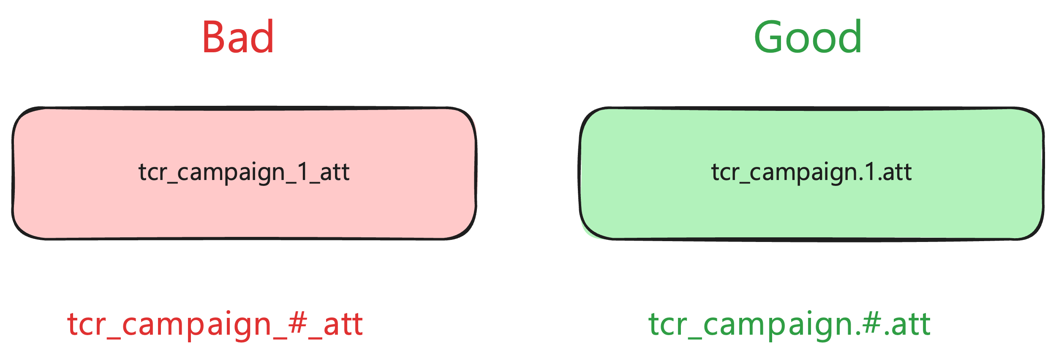
Notes:
The big thing to understand is that Rabbit uses `.` as the delimiter between words in a queue name. And you can use `#` and `*` as wildcards in routing keys.
We made the mistake of using underscores as delimiters between some parts of the queue name and dots for others. It wasn't causing any current issues for us, but would have cut off future options. Fixing it while the system was not being used was easier.

Slide 68

Campaign Worker Memory Usage
Notes:
After we brought the system up again, we had another change to make.
In Elixir, we often brag to other communities about how little memory our processes use.
However, this gets thrown out the window if you do stupid things at scale. Yeah, the BEAM process itself is cheap. A GenServer a bit less cheap. When you have thousands of processes and don't pay attention to what state you're throwing into that process, you end up in a sub-optimal place.
Luckily, this one didn't burn us. There was no production incident out of this one. But there probably would have been one at some point.
The main issue was that we were passing an Ecto schema struct into each process. That's reasonable. The mistake was then storing that struct, with all of its preloads in the process state. We should have only been storing the pieces of information that were relevant for the process.
Making this change saved us over 1GB of memory on each node.

Slide 69

Act III: The Processing
Notes:
And that brings us to our final big incident. This came from a change that we thought was pretty safe.
Verizon wants us to rate limit messages per phone number, not per TCR campaign. This change was going to create over 10K more queues in our system, along with consumers for each of them. This was a lot, but we had bought ourselves a lot of memory overhead by both increasing the size of each node in our Rabbit cluster and by consolidating our DLQs. We had plenty of CPU and memory this time to add that many queues.
Instead, we got hit by an unexpected problem. One that I had actually been wondering about sometime in previous weeks leading up to this.

Slide 70
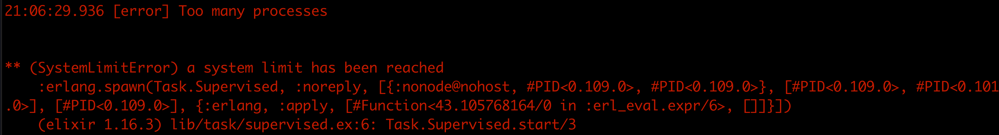
Notes:
Has anybody ever seen this error message in prod? I had been idly wondering what the failure mode was when the BEAM hits the process limit. Now our entire team knows.

Slide 71

BEAM Process Limits
Notes:
Before this project, our system didn't create many processes. Of course we had processes for Phoenix requests, Live View, Ecto, and the other usual suspects, but we hadn't done any heavy, heavy usage of processes ourselves. We noticed that the process usage was creeping up as we turned on release groups, but didn't think much of it. We still had a lot of head room.

Slide 72
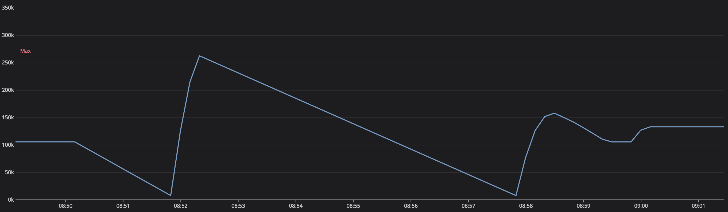
Notes:
This was another issue where we didn’t have good monitoring or alarms. When turning on release groups at night, we were checking what percentage of our process limit was being used. At the time, that was only 30%. The mistake was not realizing that the number was growing during the day as campaigns opened up. During the day we were peaking at ~60%.
Rabbit wasn’t going to have any issue opening up so many new channels for each consumer, but our Elixir nodes reached the process limit. We were creating ~12K new queues in Rabbit and Broadway consumers in our app. Each consumer is itself a supervision tree. Our Broadway configuration creates 7 processes per consumer. 12K * 7 = 84K new processes. Luckily, this was pretty early in the morning when the system was barely being used. We were able to quickly rollback the change and clean up any messages that had ended up in DLQs.
I ran a script to delete all the new phone number queues from Rabbit while we started reading docs to update our process limit. There is a flag for this, but we need to do some experimentation to find out what number will work will with the size of our nodes in k8s.
We haven’t actually upped this limit yet. Verizon phone number rate limiting is something we want to come back to, but it hasn’t been high enough priority to come back to yet.

Slide 73

All Release Groups Live
Notes:
Shortly after that incident, we were able to turn on the final release group and have all traffic now flowing through the Super Collider. Since then we’ve fixed several other issues though.

Slide 74

Invest In Custom Tooling
Notes:
Incident responses have often been painful because we didn’t have good tooling to recover messages once the system was running again. After the process limit incident, we got more serious about this.
First, we now have tooling to easily shovel messages from DLQs back to their origin. This took something that previously required navigating through either the RabbitMQ management dashboard or working directly in prod through IEx, and turned it into a couple of clicks on a DLQ dashboard in our staff tooling. That dashboard also gives us visibility into what DLQs even have messages in them right now. That’s been a huge time saver. It’s also much less risky than working in IEx in prod. It’s fantastic that we can do that in Elixir, but you shouldn’t need to do it for common tasks.
Another one is a button to restart TCR campaign supervisors. We don’t know why yet, but sometimes they get stuck with unacked messages. Having a single button that support or development can click to kick the tires on those is great.
We’re also experimenting with cron jobs that proactively look for degraded campaigns. This exposed that we need to some more thought into what it means for a campaign to be in a degraded state, but I’m hopeful that self-healing jobs like this can be a regular part of our system going forward. Ideally, you wouldn’t have any issues and nothing would need self-healing, but that’s not reality.

Slide 75

Prioritize Monitoring
Notes:
Another win has been taking the time to improve our dashboards in Datadog. Telemetry is only one part of observability. You need to take the time to use that telemetry to build nice dashboards and monitors.
You need to be thinking about what you're going to use that telemetry for? What is useful for real-time debugging? What is useful as historical data? What is useful for monitors so you know when the system is degraded or at-risk of becoming degraded?
If we had better monitoring beforehand, we could have avoided so much pain around Rabbit resource usage and BEAM process limits. I’m sure there are other things we’re not monitoring now that we should be, but learn from each incident to improve your monitoring.
Take the time to learn your monitoring tools. These tools are incredibly powerful. They have an overwhelming number of features. It is worth the time and effort to learn how to use them.

Slide 76

Consumer Creation Order
Notes:
One other minor change we made was to consumer creation order. We started seeing occasional errors with unrouted messages when campaigns would open up on the hour. The issue turned out to be that a campaign would have messages waiting to go out sitting in the campaign queue. The campaign consumer was started first and started processing messages while the carrier consumers were being started up. Sometimes the campaign consumer would start publishing messages to carrier queues that hadn’t been created yet.
The solution here was to start consumers from back-to-front in the pipeline. This ensures that the queues for later stages always exist before earlier stages start up and try sending messages to them.
And vice-versa for shutdown. We always shut down dynamic consumers from front-to-back in the pipeline.

Slide 77

Next Steps
Notes:
And that ‘s roughly where we are today. But we do have several other improvements on the docket. We expect to get to some of these before the election, but others will probably wait until after.

Slide 78
Auto Archiving Campaigns
Notes:
The first one is auto-archiving campaigns. For years, we’ve had an issue where there are no rules for auto-archiving old campaigns. It’s been an annoyance, but the way the Super Collider works has made addressing it a higher priority. We’re creating a lot of consumers and queues that don’t have any messages flowing through them.
This issue is that most of the ”active” campaigns in our system haven’t actually had messages sent through them in months. But a customer could sign in at any time and send a message through them.
We had attempted to work around this earlier, but ended up reverting that change. We had tried to not open consumers until somebody actually tried to send a message on a campaign. We could revisit that in the future, but it doesn't solve the problem of a queue already existing. And queue count has been our enemy.
The fix is to define rules for auto-archiving campaigns and run a nightly job to close them. Depending on how strict we are with those rules, we think we can reduce the number of active campaigns in our system by 40-65%. That’s a huge savings in number of queues and Broadway consumers.
These changes will hopefully allow us to reduce our resource usage in Rabbit by over 50%. That's huge. It gives us a ton of room to grow going forward and opens up the possibility of slimming down our spend on RabbitMQ post-election.

Slide 79
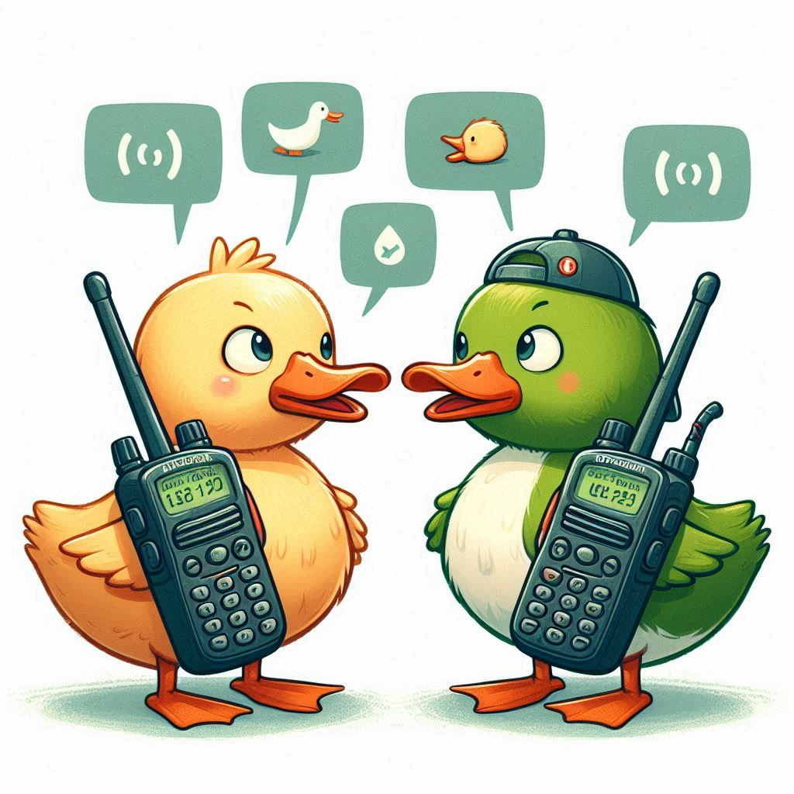
Do Not Share Channels
Across Processes
Notes:
We talked earlier about our custom channel pool that we hook into Broadway. However, not all channels in our system are related to Broadway consumers. We also have channels to manage some parts of our topology and, most importantly, to publish messages. All the same rules about not reusing channels across processes apply here as well. Let's walk through an example.

Slide 80
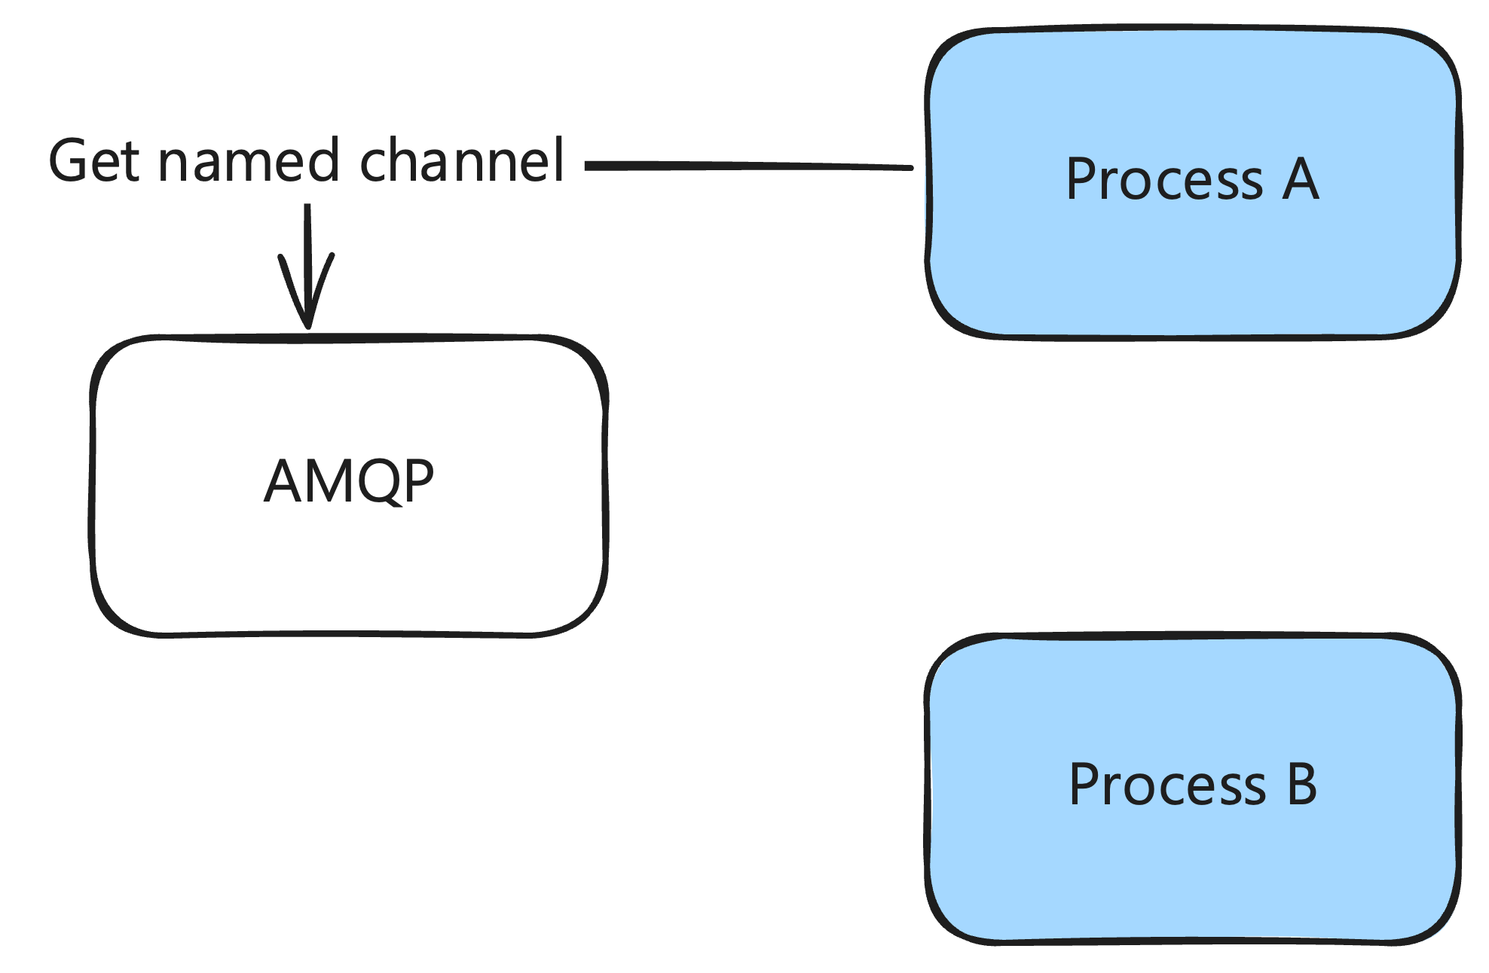
Notes:
Let's say process A get a named channel through AMQP.

Slide 81
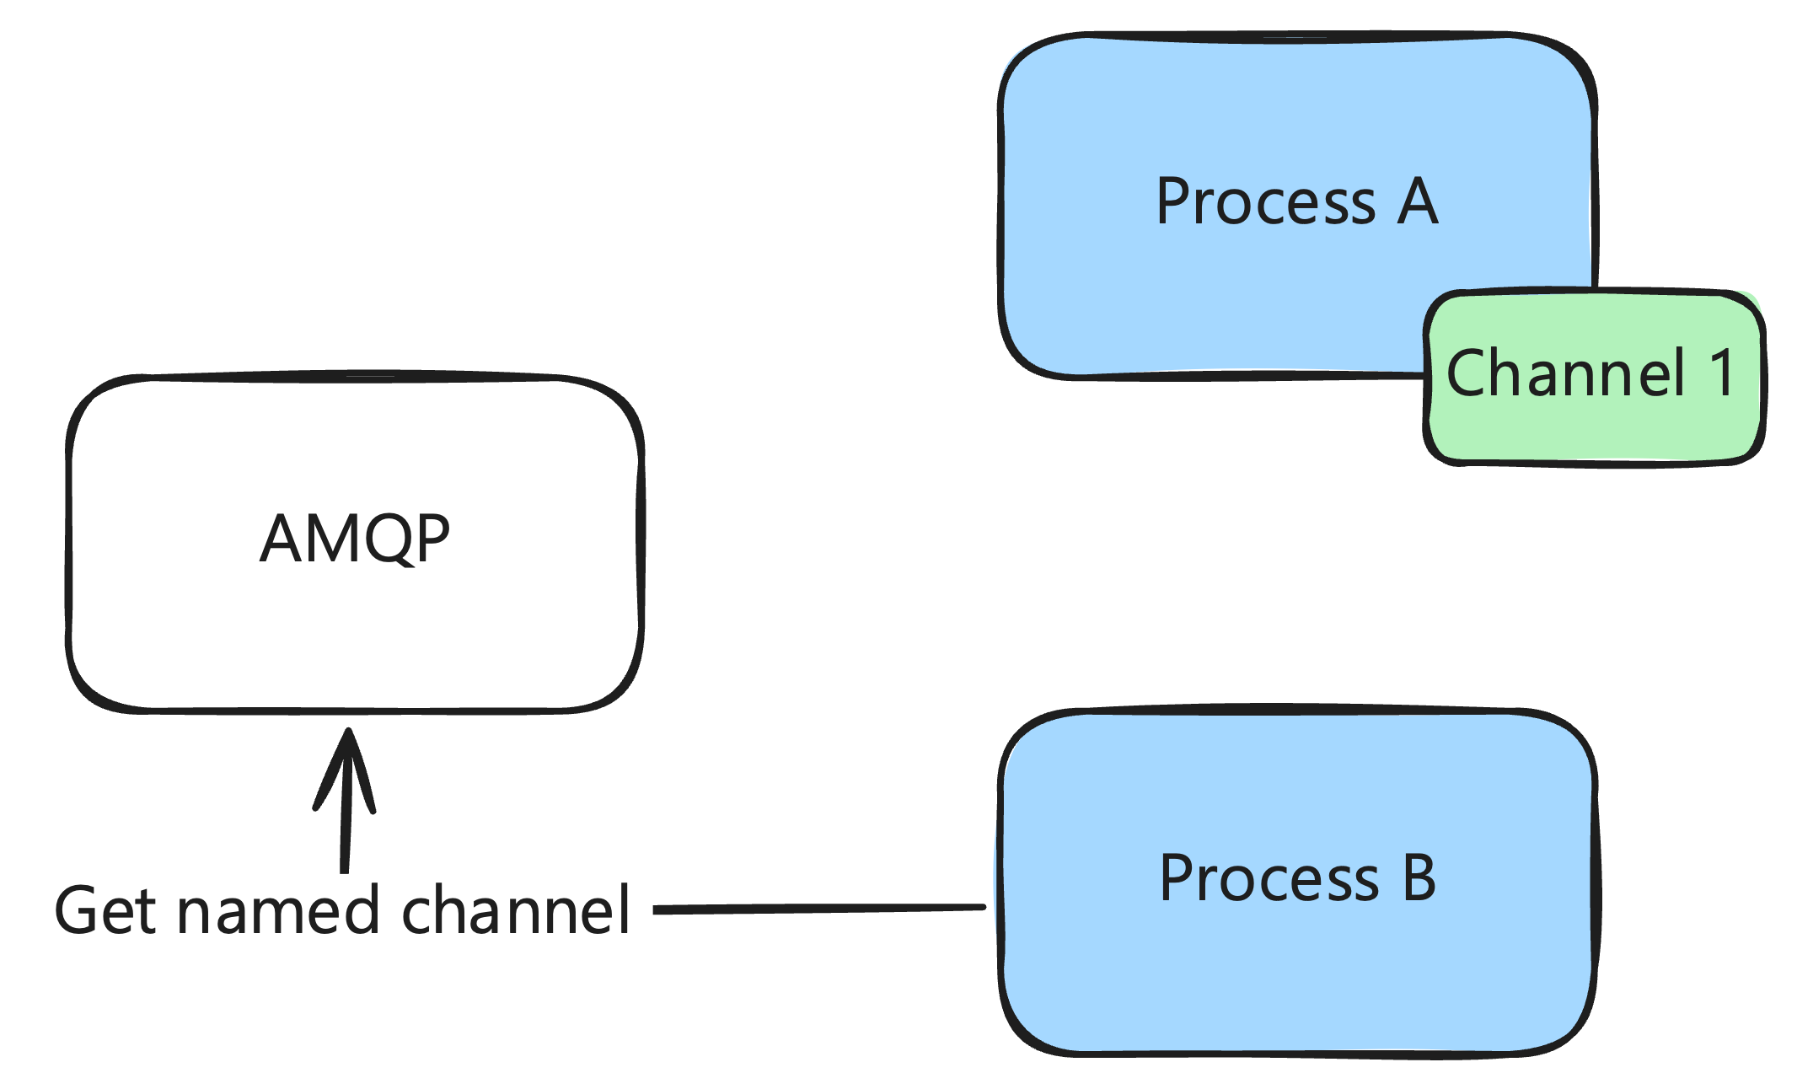
Notes:
Process A has a reference to a channel 1. This channel is a process with a PID. Process B also gets a channel with the same name.

Slide 82
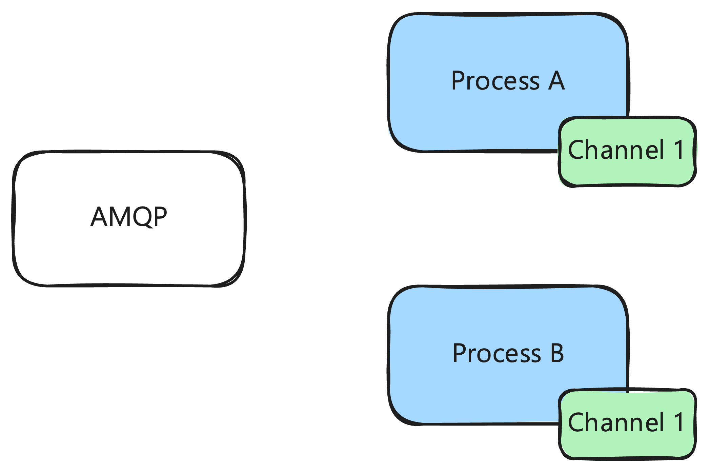
Notes:
We can see that it is the same channel. It has the same PID. This is the same channel being shared across processes.

Slide 83
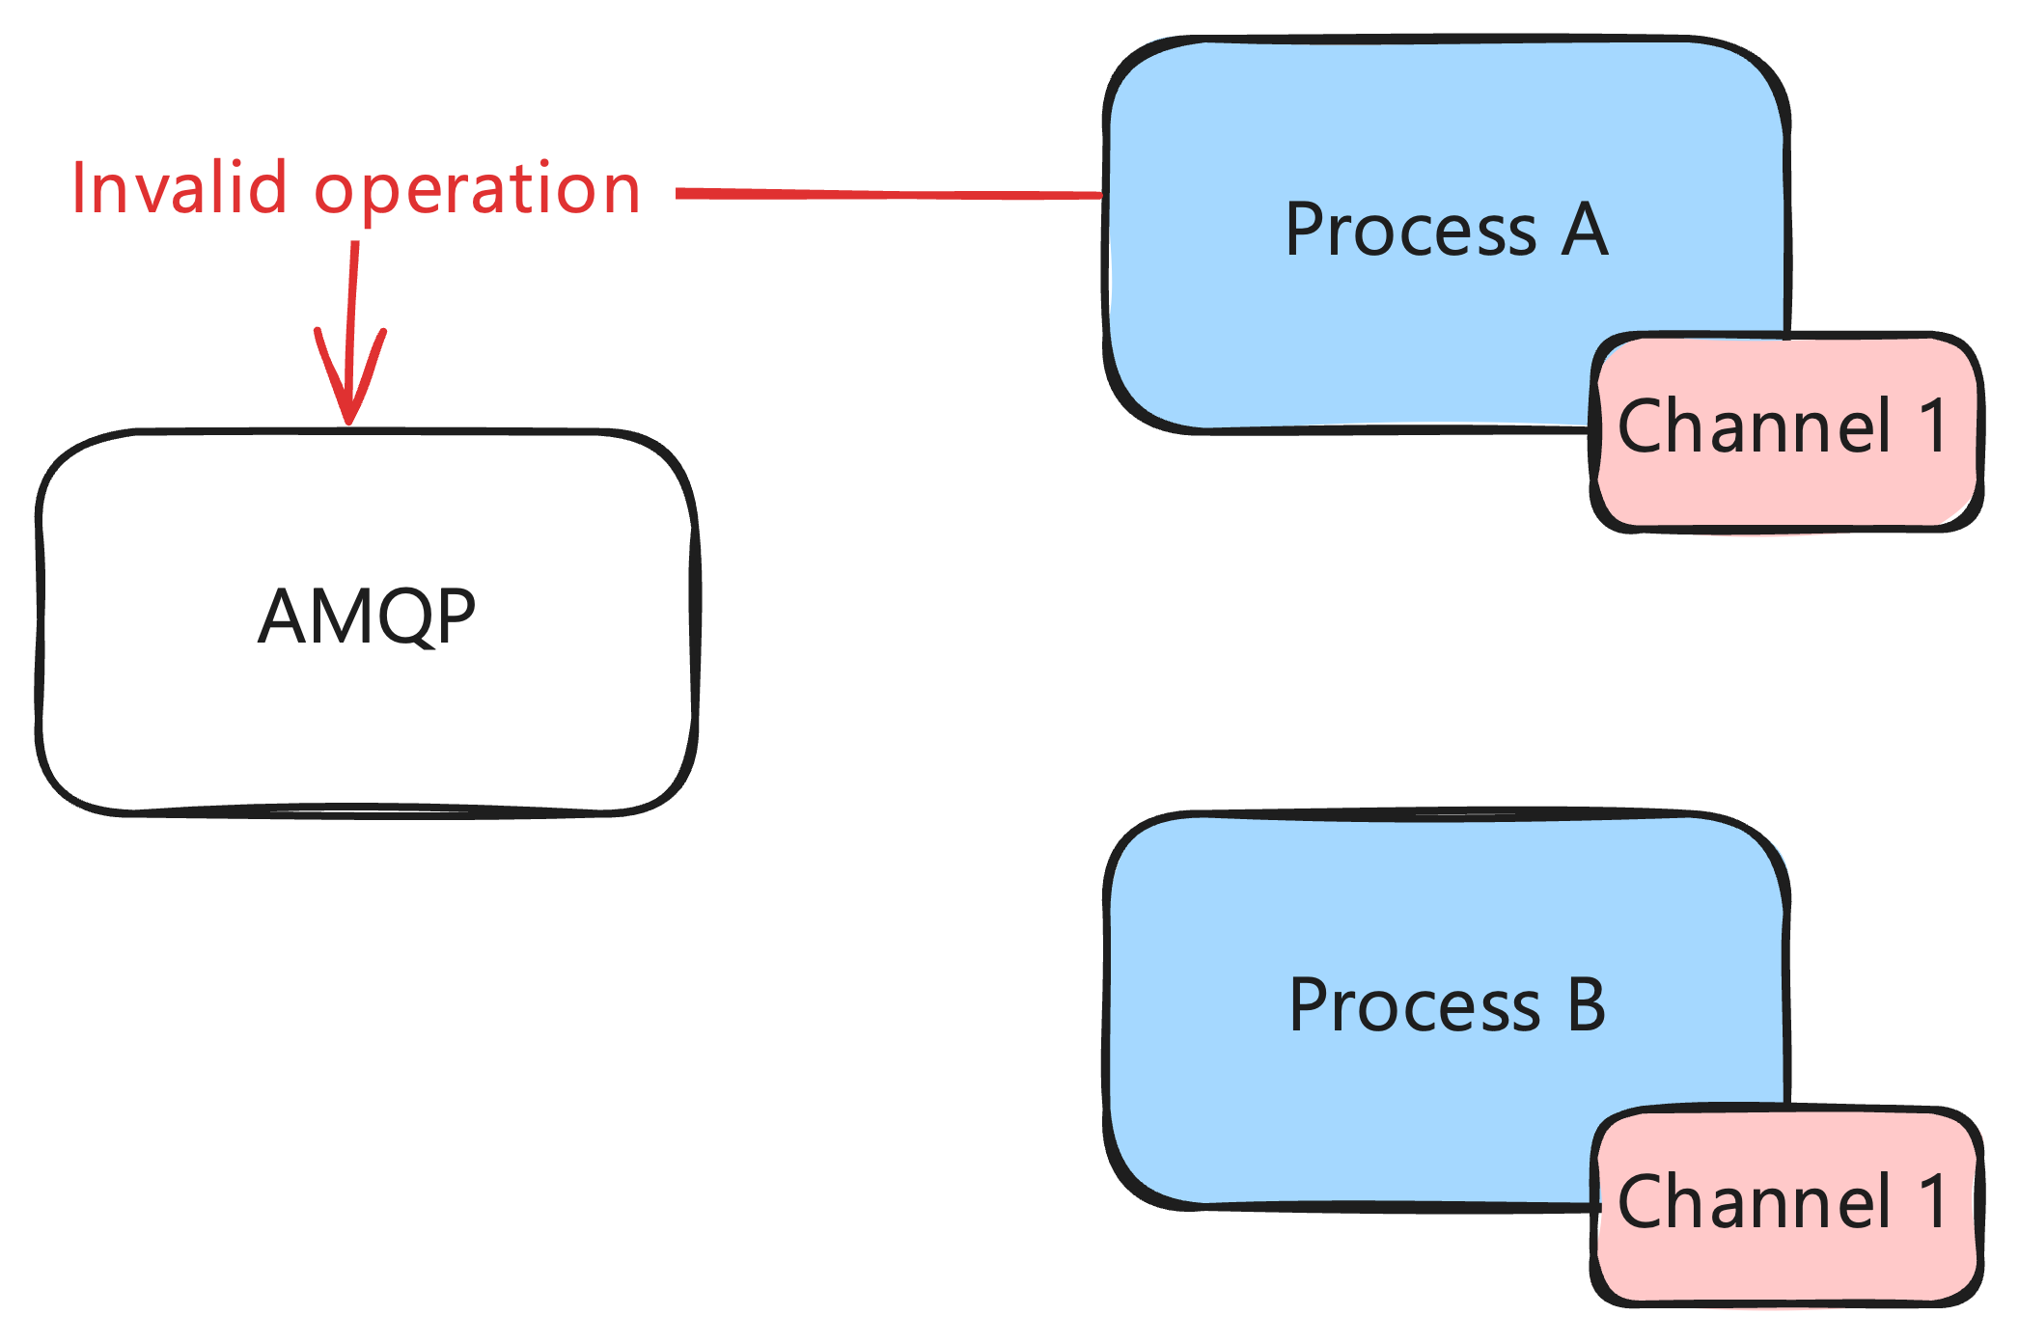
Notes:
Process A performs an action on the named channel that causes the channel to be closed, such as attempting to get the status of a queue that does not exist.
Process A can see that something went wrong and that the channel is closed. Process B can not. It won't know that the channel is closed until it tries to perform an operation on the channel.

Slide 84
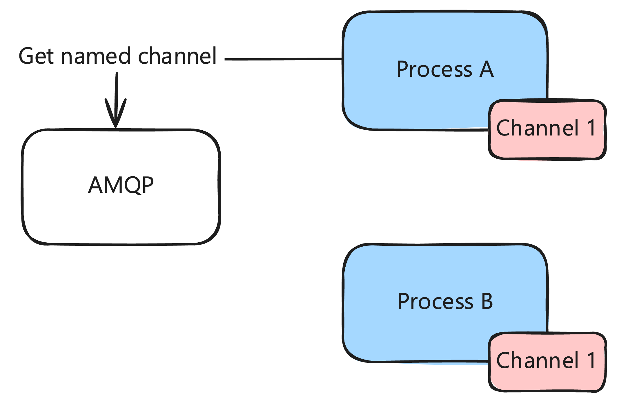
Notes:
AMQP does reestablish the channel, but it is a new channel with a new PID. You have to get the named channel again to get the new one.

Slide 85
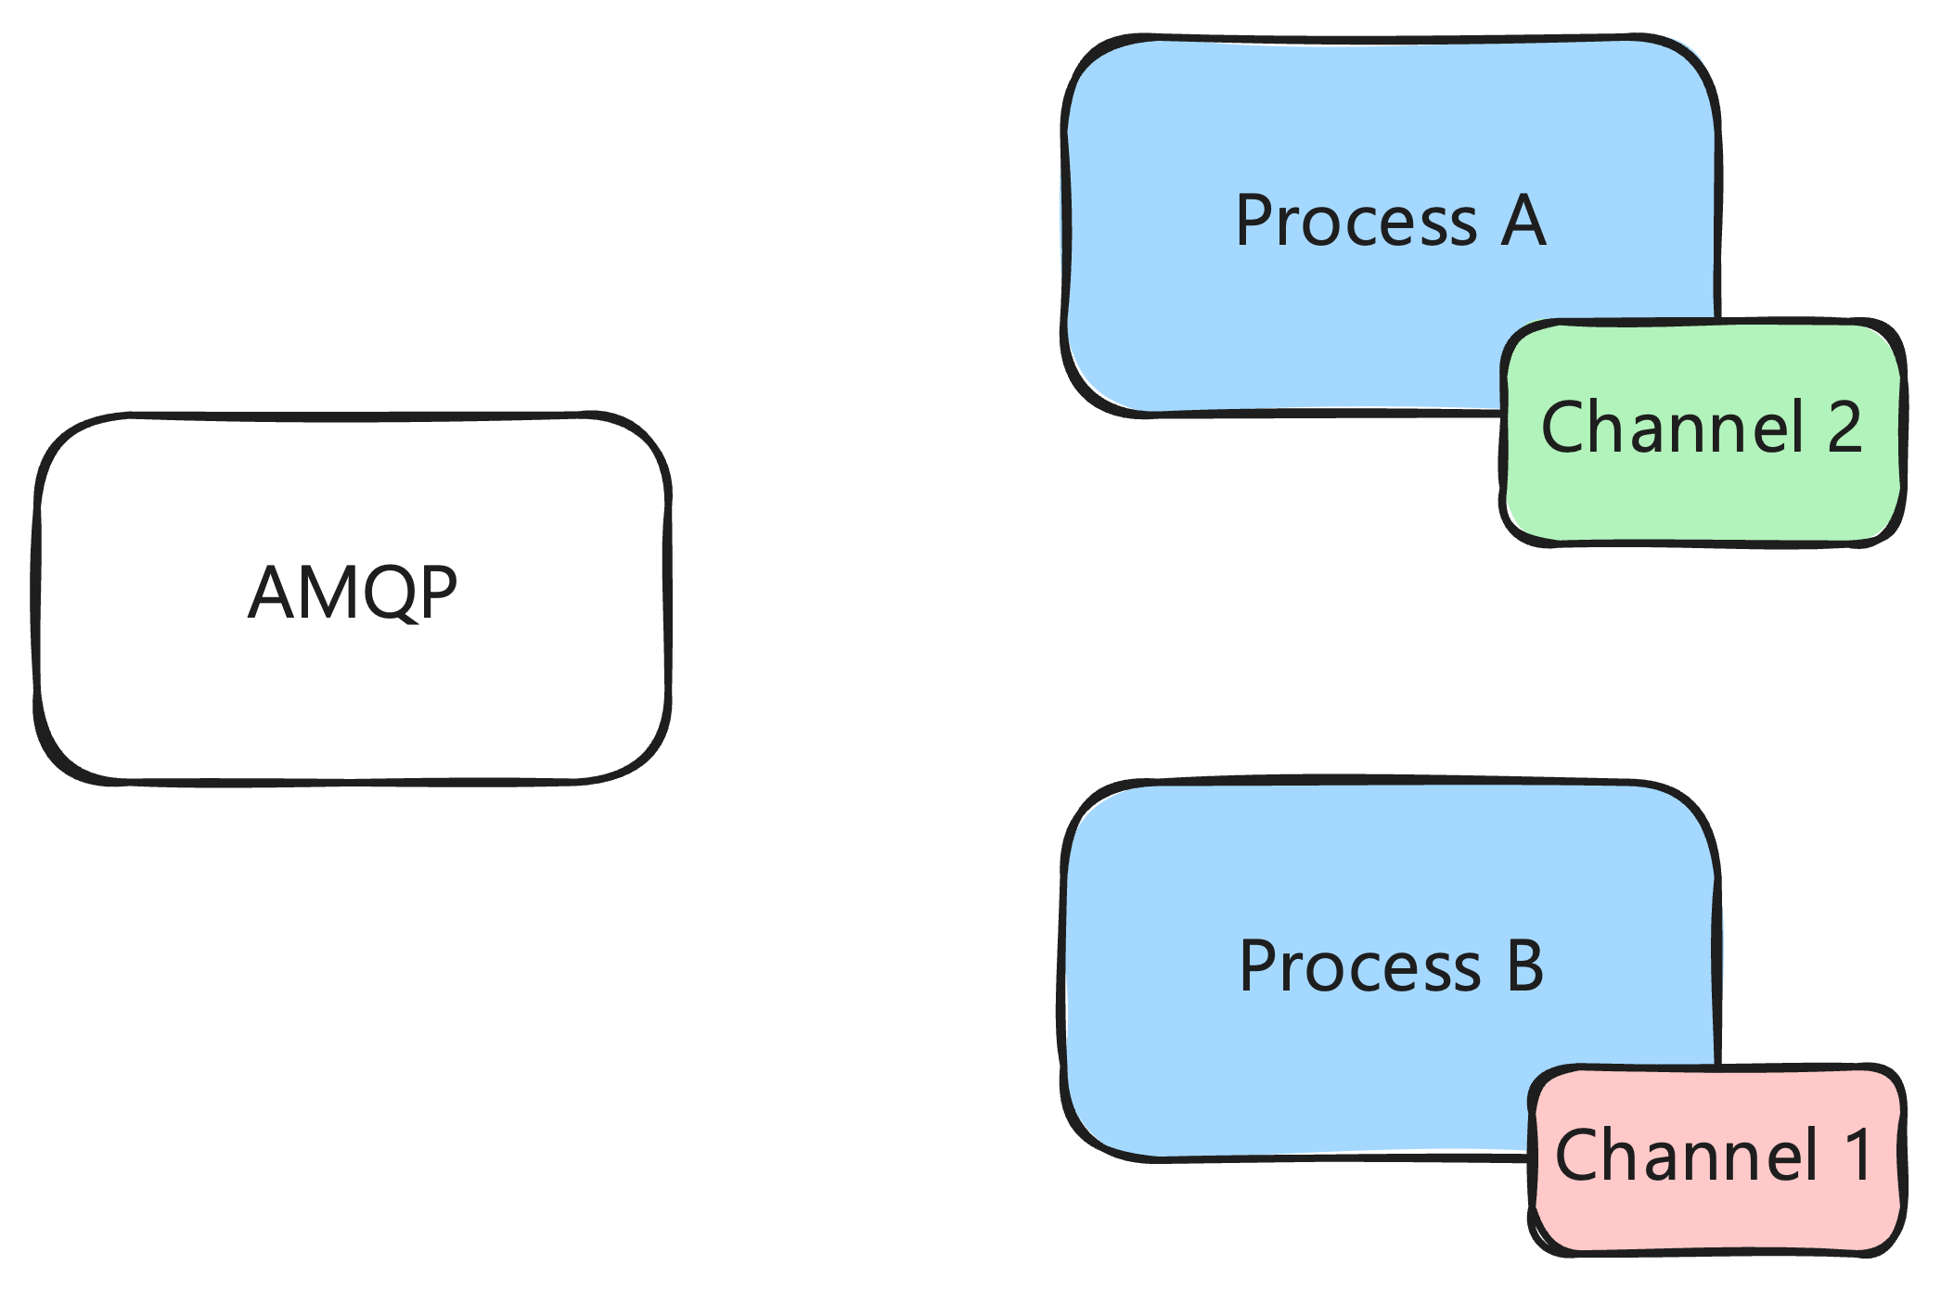
Notes:
At time of writing, we haven't fixed this yet. It's probably the highest priority bug left in our system. We're pretty sure it leads to sudden bursts of errors we sometimes see.
The solution is simple. Do not share channels across processes. Depending on your use case, each process could create their own channel or they could check one out of a channel pool. In our case, we should probably have a channel per processor for publishing. This will avoid a lot of churn in channels. Each processor is a long-lived process inside of Broadway that handles many messages.

Slide 86

Circuit Breakers
Notes:
Currently, we can pause individual campaigns to stop their messages from processing. That’s a nice start, but we need the ability to turn individual stages on and off.
At the very least, we would like the ability to trip the breakers manually. Once we have that, we can look at automating tripping the breakers in response to various metrics. For example, it a high percentage of API calls to a 3rd party are failing, we probably want to trip the breaker for that stage while we triage the issue.

Slide 87

There Can Be Only One
(Or a Few)
Notes:
Currently, for every campaign, we run all the consumer processes on every node. If we have five nodes in our cluster, we divide our rate limits by five and run consumers for that campaign on every node. For one campaign, that means each node runs all the Broadway consumers for it. The question then becomes, how much redundancy do we actually need?
It probably isn't necessary for us to be running all the consumers on each node. Most of them sit around doing nothing all day. The static consumers and queues are constantly seeing traffic, but the dynamic ones for each campaign are not.
The question then becomes, how many should we be running? Should we be running on more than one node? Is one just enough? We need to spend time investigating our options with tools like Highlander and Horde.
My initial impression is that a singleton pattern with Highlander is a good choice for us, but it’s also possible that we want redundancy still with a library like Horde. At each stage of the pipeline, processing a message is cheap. Some stages are IO bound by 3rd party API calls, but none of the stages are CPU bound.
This is another case where we probably need to use these libraries in anger to learn the intricacies of using each in production. We need to learn the failure modes of each before bringing them into our core infrastructure. It's another opportunity to drastically lower the number of channels and consumers in our system though when we need to scale more.

Slide 88

Audit Trails
Notes:
As we’ve turned down telemetry to avoid burying our Datadog agents and spending a fortune, we’ve lost some of the nice audit trails we got for every message going through the SC. We can still answer a lot of questions, but not as much as we used to.
We need to explore options for an audit trail of messages as they flow through our system. This is detailed data we would keep around for a limited amount of time to help with debugging of recent issues. There are a lot of options for how we could both collect and store this information, but we haven’t decided on a direction yet.

Slide 89

Do We Need Broadway?
Notes:
Finally, it's not clear that we should be using Broadway at all. Given our use case, it's possible that we should be using GenStage directly to build our our own pipeline. We’ve already forked Broadway so we can add weights to messages. Maybe we should be doing that at the GenStage level.
I think using Broadway to start was absolutely the correct decision. We didn't have a good enough understanding of the problem space, Broadway itself, and GenStage. But it may not be correct for us to use long-term.

Slide 90


Notes:
I highly recommend Concurrent Data Processing in Elixir to better understand the separation. It didn't click at all for me until I read it.

Slide 91




Our Team
Clay
Matt
Joanna
Chris
Notes:
Many thanks to everybody I work with at GetThru. I'm the one up here talking, but the entire team worked on this project in various ways.

Slide 92

Website
https://brianmeeker.me
Mastodon
@brianmeeker@hachyderm.io
Any questions?
https://github.com/CuriousCurmudgeon/messaging_with_limits_talk
Notes:
Overall, we're pretty happy with what we've built. We recognize there is a lot of polish to be done over time, but we're confident that we have a system that can stand up under the load of an election season.
If you have any questions, come on up and chat or find me later. You can also track down my co-worker, Chris, who is here as well
The slides will be available on GitHub and you can find me on Mastodon. Thank you and enjoy the rest of your day.
Any questions?

